Slide 1
WELCOME to the DEPARTMENT OF PURE AND APPLIED CHEMISTRY

Slide 2
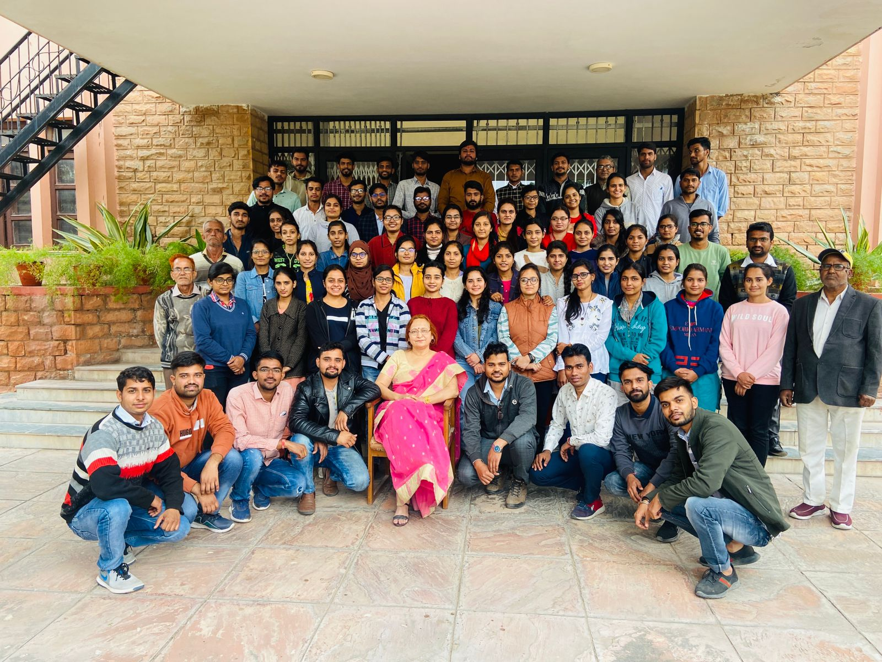

Slide 3
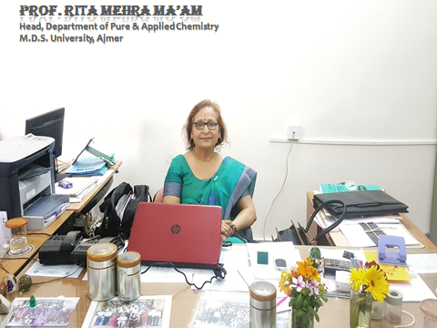
FOUNDER MEMBER OF THE DEPARTMENT AND
FIRST LADY FACULTY OF THE UNIVERSITY

Slide 4
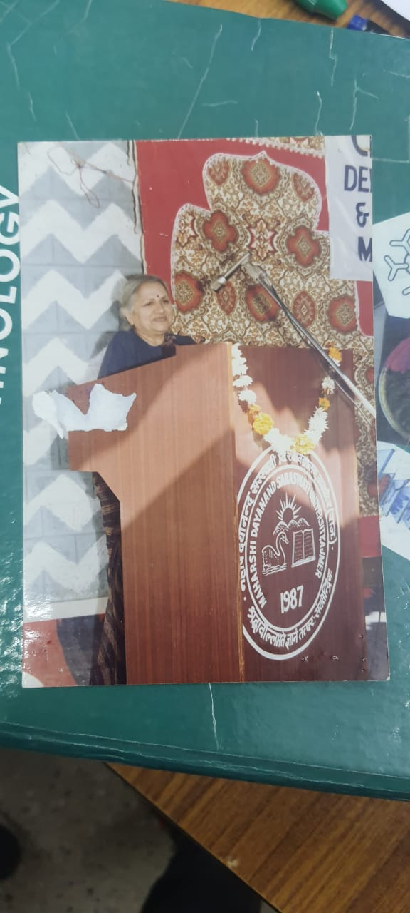
Department of Pure and Applied Chemistry
Date And Year Of Establishment –
19th April 1994
Under Vice-Chancellorship of Prof.(Dr.) Kanta Ahuja

Slide 5
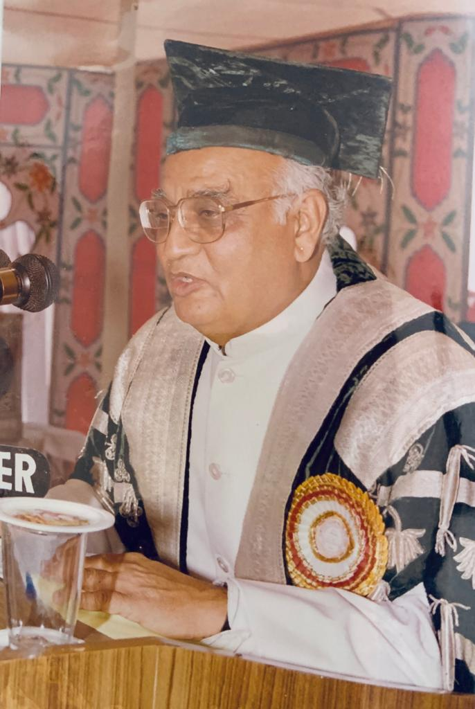
Courses Offered by the Department
M.Sc Applied Chemistry
(From 1994 till date – Regular Course)
2 year degree course of 4 Semesters
M.Sc Chemistry
(From 2000-2007-Regular Course)
(From 2007 till date – SFS Course)
2 years degree course of 4 semesters
Under Vice-Chancellorship of Prof.(Dr.) D.N. Purohit,
M.Sc. Chemistry Course started in 2000
alongwith M.Sc., M.A. , M.Com etc. In the University

Slide 6
SEATS,
ELIGIBILITY
AND
SCHEME OF EXAMINATION
M.Sc. Applied Chemistry -20 seats
M.Sc. Chemistry – 20 seats
Ph.D.- 8 seats
Percentage of Girl students being greater than that of boy students
>
ELIGIBILITY FOR BOTH THE COURSES - 50% marks aggregate in B.Sc. With Chemistry as one of the optional subjects or B.Sc. Hons (Chemistry).
SCHEME OF EXAMINATION – Semester Scheme in both the courses with CBCS in M.Sc. Applied Chemistry .

Slide 7
Course Contents
Apt knowledge of subject with respect to NET, SET
Apt Subject knowledge wrt other competitive examinations
Theoretical and Practical Aspects
Of the subject As per UGC Module

Slide 8
Thrust Areas
OF Research
Biomonitoring of Metals and assessment of occupational hazards
Physical and BioAcoustics

Slide 9
Department sticks to the practices of
DISCIPLINE
PUNCTUALITY
REGULARITY
OBEDIENCE
Power Point Seminar Presentation Mandatory in the Last Semester so that the students become abreast of the modern teaching - learning aids.
Organization of Co-curriculur and Cultural Activities.
Organization of Seminars subject to availability of funds.

Slide 10
FACILITIES for the students
Atomic Absorption Spectrophotometer ECIL Make
Gas Chromatograph Systronics Make
Anton Paar Densitometer
UV-Visible Spectrophotometers Systronics make
Double Beam Visible Spectrophotometers Systronics Make
Digital Flame Photometers with Na, K,Ca,Li filters Systronics Make
Electronic Balances upto four digit accuracy in each laboratory Citizon Make
Fuel Testing Instruments- Abels and Cleaveland Flash Point Apparatus

Slide 11
Red Wood Viscometer A and B
Cloud Point and Pour Point Apparatus
pH meters with ATC of Elico, Systronics, Toshniwal and Digital pH Meters Chino Make
Conductivity Meters with ATC Systronics, Chino and Rescholar Make, Muffle Furnace etc.
Blood Bank Refrigerator
Refrigerated Water Bath with Circulating Medium
Water Baths with and without thermostatic control
Hot Air Ovens
Ice-Flaking Machine
Water Stills
Serological Water Bath

Slide 12
Laminar Flow
Fume Hood
BOD Incubator
Double Distillation Unit
Fire Point Apparatus
The Department is also equipped with safety equipments such as Fire Extinguishers , Eye Wash Station, Fire retarding material to meet with any emergent unfortunate but accidental situations, if any.

Slide 13
Departmental Library
Number of books – 75 from out of one time grant of Rs 50,000/-
Personal Library of H.O.D.
The Head of Department has a collection of ABOVE 300 books in Inorganic, Organic, Physical, Analytical Chemistry which are placed in two Book Cases in the HOD Chamber and which are available to students.
Computers, Internet Access to students related facilities
Computer Room - One with four Computers available for students for practice and for Prepration power point presentation of their Seminars, and also one in research lab. The students have Internet Access as the University Campus is Wi-Fi and LAN connectivity.

Slide 14
Pass % in last decade
YEAR
2011-12
PASS % IN
M.Sc. APPLIED CHEMISTRY
100%
M.Sc. CHEMISTRY
2012-13
2013-14
2014-15
2015-16
2016-17
2017-18
2018-19
100%
100%
100%
100%
100%
100%
100%
100%
100%
100%
87.5%
92%
86.9%
100%
100%
PASS % IN
COURSES

Slide 15
University Topper students of M.Sc. Chemistry and M.Sc. Applied Chemistry
M.Sc Chemistry -
2011 – Goutam Suthar(Gold Medalist)
2013 – Asha Sharma (Gold Medalist)
2014 – Rashmi Jain (Gold Medalist)
M.Sc.Applied Chemistry –
1. BHAGYAWATI VERMA - 1996
2. ASHISH JAIN -1997
3. RAJESH PRITWANI - 1998
4. PARUL AGARWAL - 1999
5. NEERU NAGPAL - 2000

Slide 16
6. NIDHI WADHWA - 2001
7. NEEMA SARASWAT – 2002
8. DIMPLE SHARMA – 2003
9. NEETU PREMCHAMDANI – 2004
10. ANJALI - 2005
11. MUKESH VERMA - 2006
12. AVI GARG - 2007
13. SAVITA SONI - 2008
14. RAKESH KUMAR JANGID - 2009
15. BHARAT KUMAR GOUR - 2010
16. KUMARI SUNITA - 2011
17. SONAL MEGHANI - 2012
18. RAVI BHATI - 2013
19. POONAM CHOUDHARY - 2014
20. NIDHI MAHESHWARI - 2015
21. NEELAM CHOUDHARY - 2016
ANUJ KABRA – 2017
SHWETA SHARMA – 2018
MAHAVEER PARIHAR – 2019
ADITI PANDEY - 2020

Slide 17
Permanent Faculty and Qualifications
Dr. Rita Mehra, Professor and Head
M.Sc.Chemistry (Gold Medalist) Ph.D.
P.G. Teaching Experience - 34 Years

Slide 18
Guest faculty on lecture basis and their Qualifications –
Dr. Arun Sharma – M.Sc. (Chemistry) Ph.D., NET.
Dr. Mukesh Sharma - M.Sc. (Applied Chemistry) NET-JRF Ph.D., PDF - Univ. of Aveiro.
Dr. Shilpi Vats - M.Sc. (Chemistry) Ph.D.,M.Phil.
Mr. Abhishek Tilkar – M.Sc. (Applied Chemistry) NET.

Slide 19
Visiting Faculty From Inside and Outside the State of Rajasthan.
1. Prof. J.D.Pandey, Emeritus Fellow UGC and Former Head, Department of
Chemistry, University of Allahabad (U.P.)
2. Prof. K.S.Gupta, Emeritus Scientist DST and Former Professor , Department of Chemistry, University of Rajasthan, Jaipur,( Rajasthan)
3. Prof. K.K.Mishra, Former Head , Department of Chemistry, Rani Durgavati University, Jabalpur, (Madhya Pradesh)
4. Prof. Amalendu Pal, Emeritus Scientist DST and Former Head, Department of Chemistry, Kurukshetra University, Kurukshetra (Haryana)
5. Prof. D.I.Brahmbhatt, Former Head, Department of Chemistry, Sardar Patel University , Anand, (Gujarat)
6. Prof. C.P.Bhasin, Professor Department of Chemistry, Hemchandracharya North Gujarat University, Patan (Gujarat)
7. Prof. K.H.Chikaliya, Professor ,Department of Chemistry, Gujarat University (Gujarat)

Slide 20
8. Prof. S. Sanyal, Former Professor and Head, Department of Chemistry, Sahibganj, (Jharkhand)
9. Prof. R.R. Jha, Former Professor ,Department of Chemistry, Ranchi University, Ranchi(Jharkhand)
10. Prof. R.K.Bansal, Former Professor . Department of Chemistry, University of Rajasthan, Jaipur (Rajasthan)
11. Prof. J.D.Joshi, Former Head ,Department of Chemistry, Sardar Patel University, Anand (Gujarat)
12. Prof. A.P.Mishra, Professor, H.S.Gaur University , Department of Chemistry, Central University , Sagar (Madhya Pradesh)
13. Mr. Rajeev Agarwal, MLV Government Textile and Engineering College, Bhilwara, (Rajasthan)
14. Dr. Amit Singh Thakur, Department of Chemistry, IPS Academy ,Indore

Slide 21
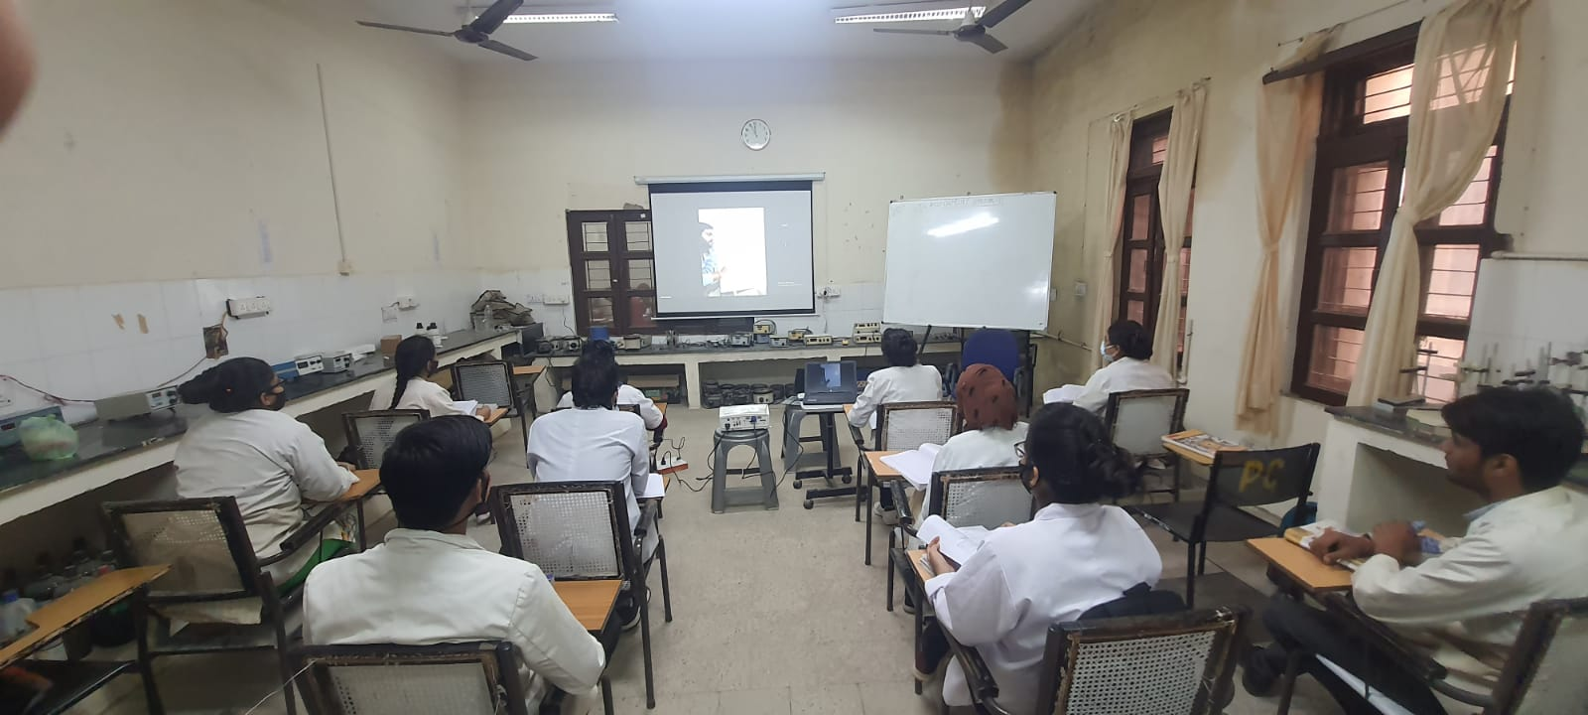
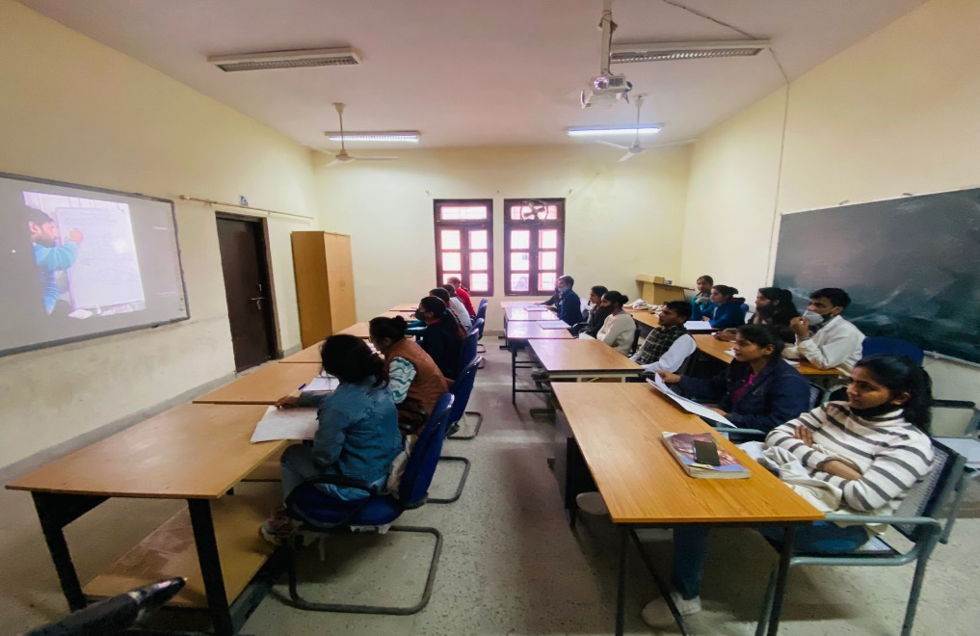
ONLINE
CLASSES

Slide 22
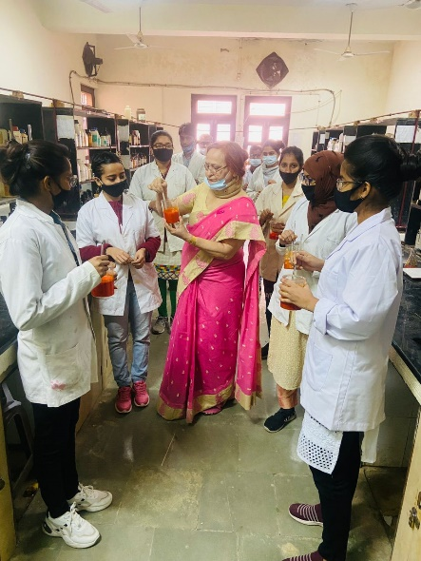
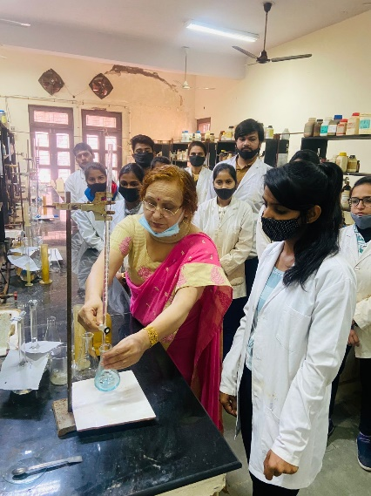
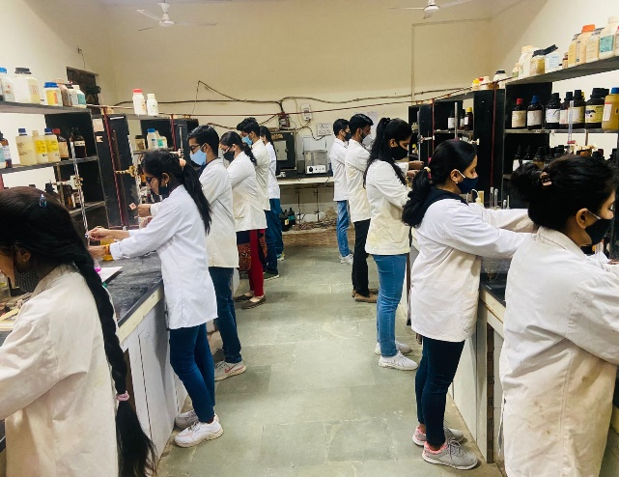
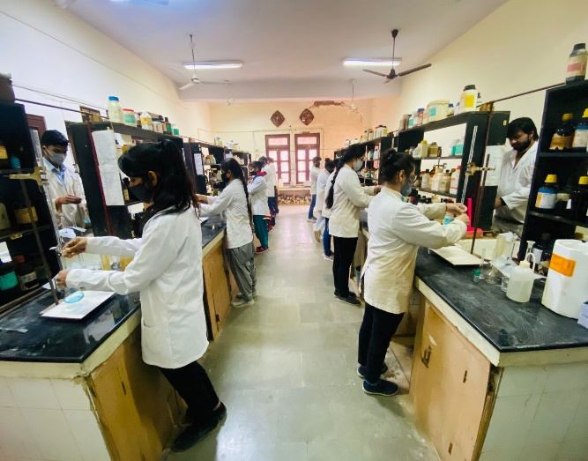
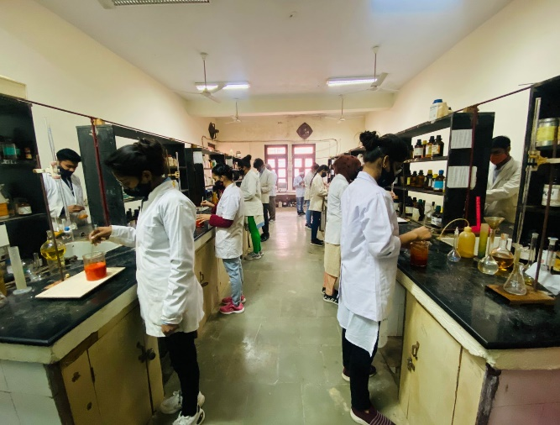
WET ANALYSIS
LAB

Slide 23
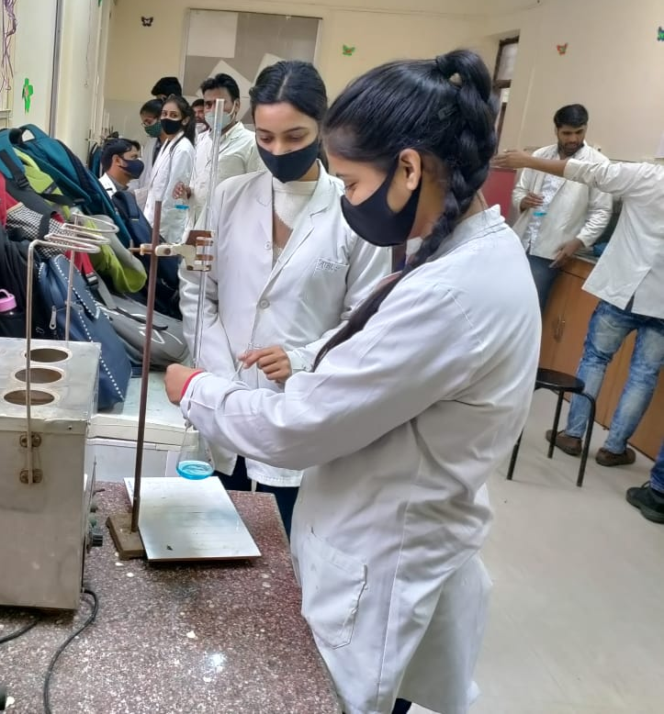
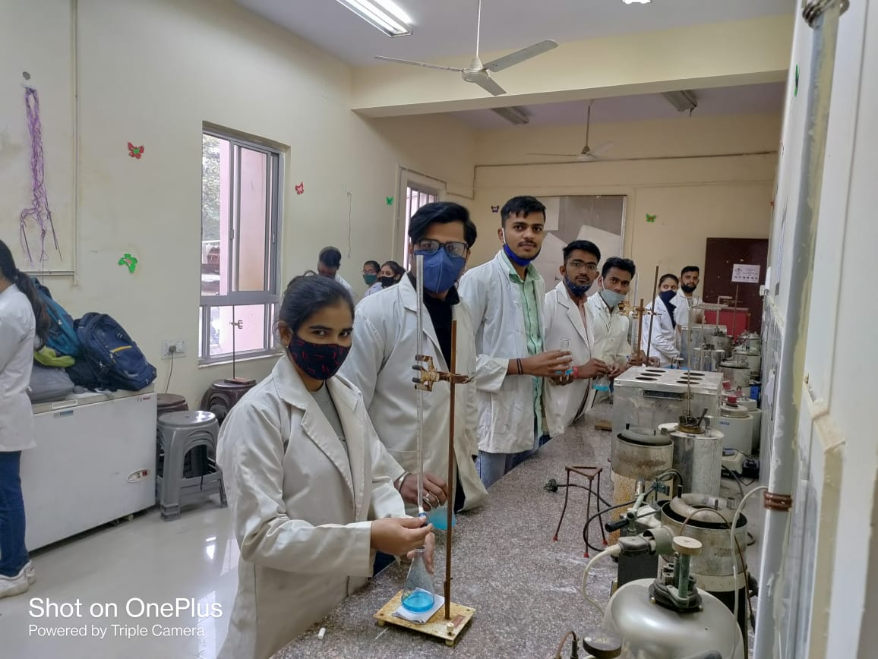
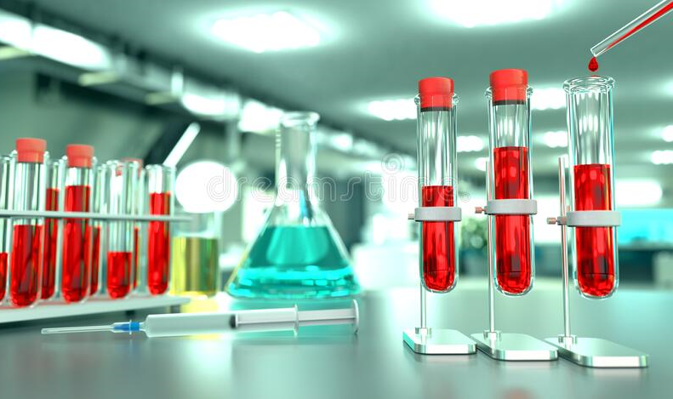
FUEL
ANALYSIS
LAB

Slide 24
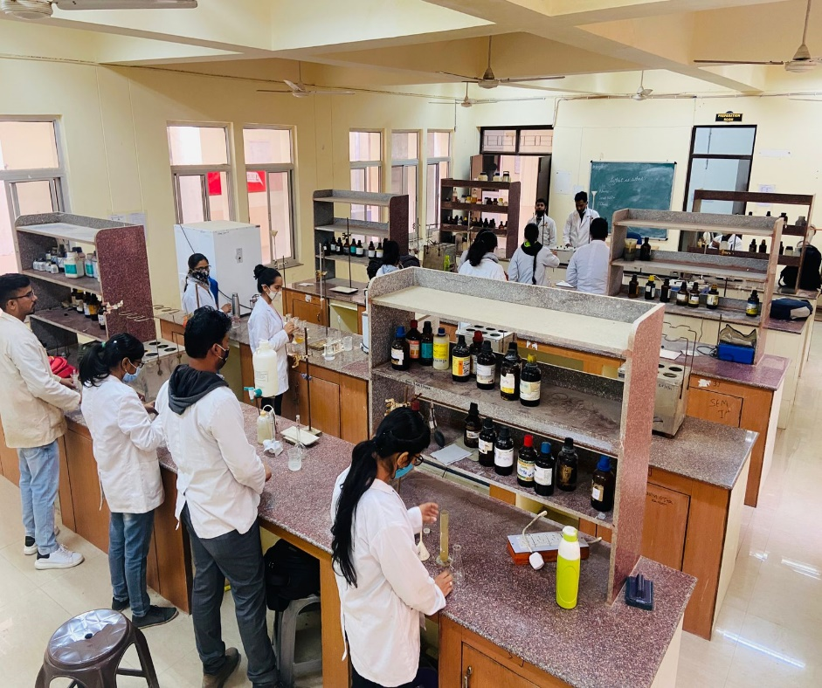
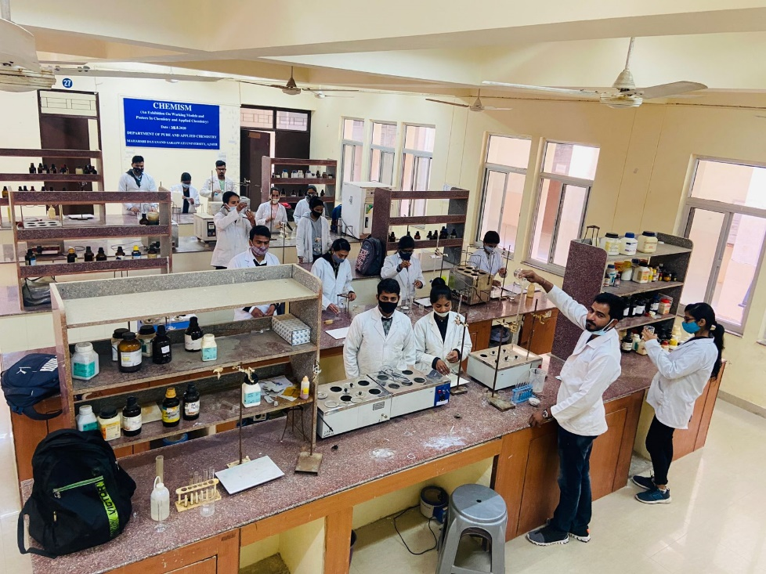
FORENSIC
LAB

Slide 25
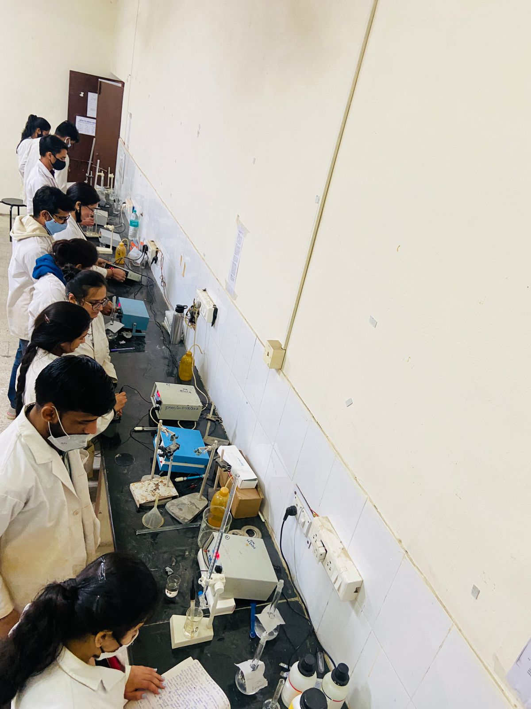
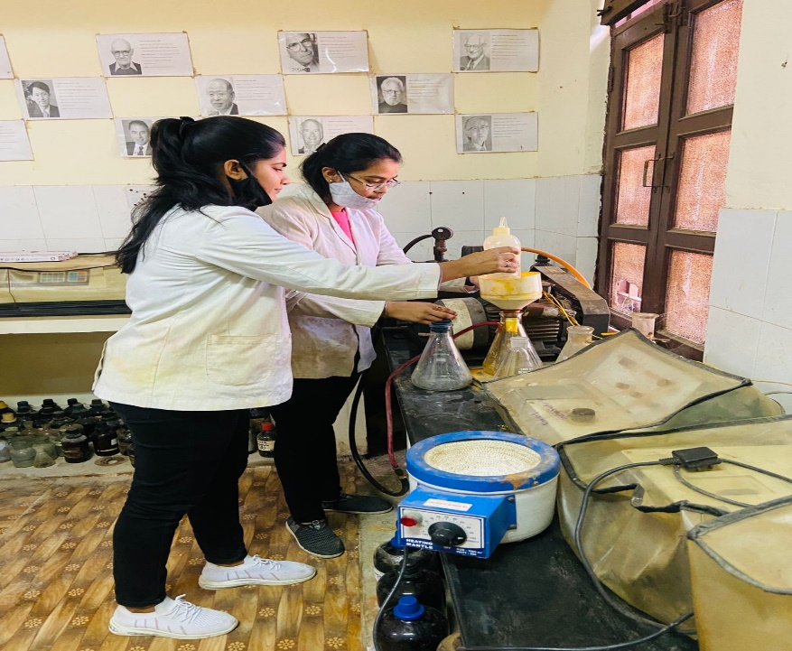
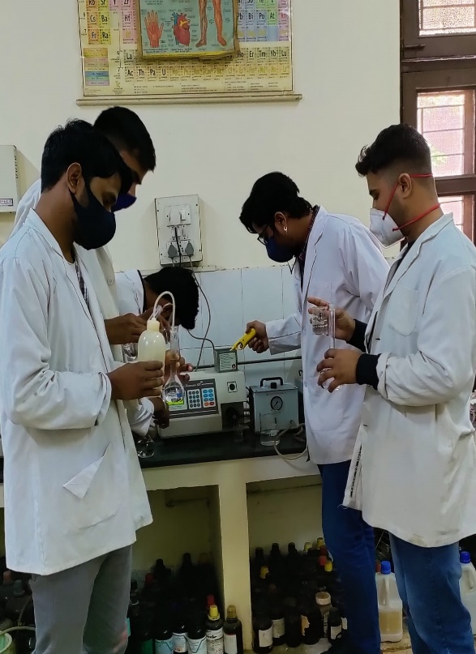
INSTRUMENTAL
LAB

Slide 26
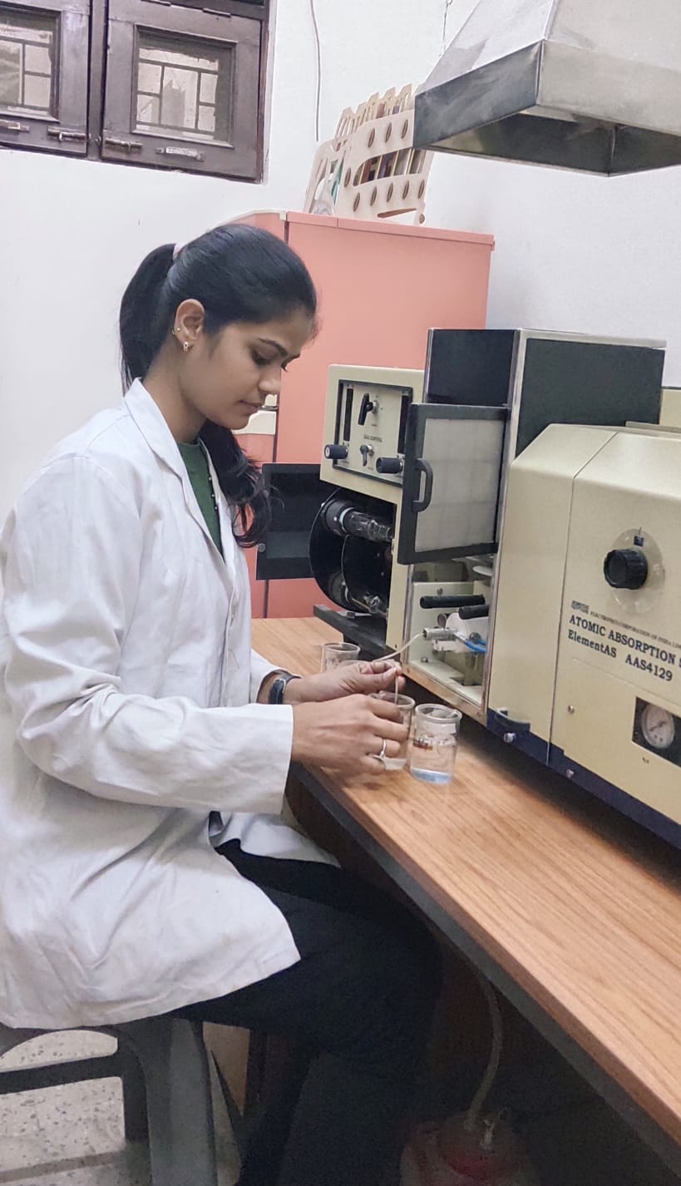
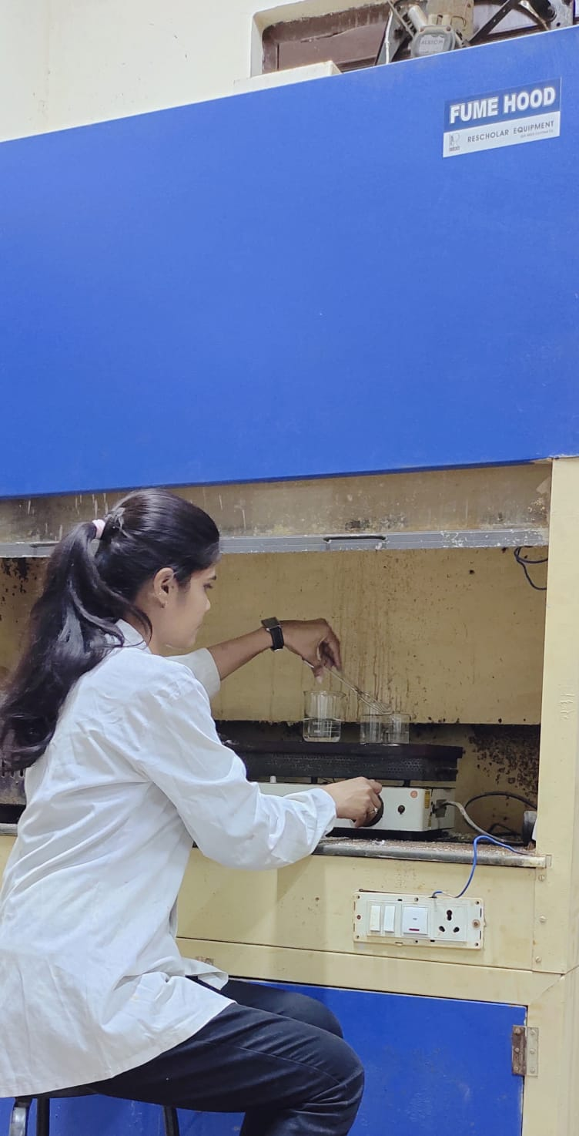
RESEARCH
LAB- ACOUSTIC AND
ENVIRONMENTAL
LABORATORY

Slide 27
Safety Measures in the Labs and Department
1.Fire Extinguisher installed outside every Lab
2.Fire retarding material in every lab
3.Instructions to students to wear shoes and come with tied hair (girl students) along with other instructions displayed in lab
4.Eye Wash Station in the lab for exigencies
5.First Aid Box Available in each laboratory

Slide 28
SOME ALUMINI FROM MANY WHO HAVE CLEARED ELIGIBILITY TEST FOR LECTURERSHIP AND Ph.D
There being no prescribed mechanism , as per verbal information of ex-students who as and when come to the Department following students have cleared NET, SLET, SET, GATE Examinations :
Jagdeesh Meena – M.Sc.Chemistry-2009- NET (JRF)GATE
Poonam Kumari, M.Sc. Chemistry, 2009, NET
Anita , M.Sc. Chemistry, 2009, NET
Abhishek Tilkar- M.Sc. Applied Chemistry- 2010 - NET, GATE
Pappu Ram Jeetarwal - M.Sc. Chem-2010- SET
Akhilesh Rawat –M.Sc. Applied Chemistry - 2010 - NET
Pappu Lal Mali, M.Sc. Chemistry, 2011, NET, SET
Rajeev Maurya, M.Sc. Chemistry- 2009, NET

Slide 29
9. Monika Rathore , M.Sc. Chemistry, 2010, NET
10. Sanwarmal Jat- M.Sc. Chemistry, 2010 – NET (JRF), SLET
11. Priyanka Kumari Badala - M.Sc. Chemistry, 2010, SET
12 .Surgyan Chand Yadav, M.Sc. Chemistry, 2010, SET
13. Rajendra Singh Katariya, M.Sc , Chemisry, 2012, SET, GATE
Mukesh Sharma, M.Sc. Applied Chemistry, 2010, NET (JRF)
Sudhir Kumar Shoora, M.Sc. Applied Chemistry, 2009 NET (JRF), GATE(2008)
Ranveer Singh, M.Sc. Applied Chemistry, 2009, NET ,SET,GATE
Arvind Kumar Meena, M.Sc. Chemistry, 2008, NET
Madhu Toshniwal, M.Sc. Applied Chemistry, 2004,SLET
Rajni Sharma, M.Sc.Chemistry, 2005, NET
Shivraj Singh Chaudhary –M.Sc. Chemistry ,2008- NET
(JRF 2009,2010,2011), GATE (2009)
Rajeev Agarwal – M.Sc. Applied Chemistry- ,2000, NET, SLET, GATE
Rajendra Kumar Singla - M.Sc. Chemistry ,2008- NET (JRF), GATE
Sumita - M.Sc. Chemistry, 2010 SLET
Poonam Choudhary, M.Sc. Applied Chemistry, 2014,NET
Tikam Chand Sharma, M.Sc. Applied Chemistry, 2011, NET
Devendra Zirota, M.Sc. Applied Chemistry,2002, NET
Rakesh Jangid , M.Sc. Applied Chemistry, 2009, SET
Jitendra Singh Shekhawat, JK Lakshmi Cement, Sirohi

Slide 30
Poonam Choudhary, M.Sc. Applied Chemistry, 2014,NET
Tikam Chand Sharma, M.Sc. Applied Chemistry, 2011, NET
Devendra Zirota, M.Sc. Applied Chemistry,2002, NET
Rakesh Jangid , M.Sc. Applied Chemistry, 2009, SET
Jitendra Singh Shekhawat, JK Lakshmi Cement, Sirohi
Devendra Zirota, M.Sc. Applied Chemistry,2002, NET
Rakesh Jangid , M.Sc. Applied Chemistry, 2009, SET
28. Renu Detharwal , M.Sc.Chemistry,2012,NET, SET, GATE
Vijay Shankar, M.Sc. Chemistry, 2012,NET
Arun Jain , M.Sc. Chemistry , 2009, NET
Beena Soni , M.Sc. Chemistry , 2013, NET
Mahendra Singh Rathore , M.Sc. Chemistry , 2012, NET
Kuldeep Rathore, M.Sc. Chemistry , 2009,NET
Anil Kumar Meena, M.Sc. Chemistry, 2013,GATE
Sunita Kumari ,M.Sc. Chemistry, 2011, SET
Shweta Badoliya, M.Sc. Chemistry , 2011, SET
Jitendra Singh Rajpurohit, M.Sc. Chemistry, 2008, NET(JRF),GATE
Rajesh Yadav, M.Sc.Chemistry,2009, NET
Kush Kumar Gulati, M.Sc. Applied Chemistry, 2009 , NET(JRF)
Krishna Kumar Sharma, M.Sc. Applied Chemistry, 2009, SET

Slide 31
Anil Kumar Meena, M.Sc. Chemistry, 2013,GATE
Sunita Kumari ,M.Sc. Chemistry, 2011, SET
Shweta Badoliya, M.Sc. Chemistry , 2011, SET
Jitendra Singh Rajpurohit, M.Sc. Chemistry, 2008, NET(JRF),GATE
Rajesh Yadav, M.Sc.Chemistry,2009, NET
Kush Kumar Gulati, M.Sc. Applied Chemistry, 2009 , NET(JRF)
Krishna Kumar Sharma, M.Sc. Applied Chemistry, 2009, SET
Nayan kumar panday M.Sc. Applied Chemistry, 2014
Manoj kumar Sepat M.Sc. Applied Chemistry, 2016
Seema Jnagid M.Sc. Chemistry, 2016 NET(JRF)
Sumitra Bera, M.Sc. Chemistry, 2016 NET
Devendra Jangid , M.Sc. Applied Chemistry, 2016 NET
Poonam Choudhary M.Sc. Applied Chemistry 2014 NET(JRF)
Pardeep Choudhary M.Sc. Chemistry, 2016 NET(JRF)
Poonam Choudhary M.Sc. Applied Chemistry 2014 NET(JRF)
Anuj Kabra , M.Sc. Applied Chemistry, 2017 NET

Slide 32
Some Alumini
There being no prescribed mechanism, as per the verbal information given by ex-students the names and placement of some Alumini are as follows:
Abhishek Tilkar, M.Sc. Applied Chemistry, Cleared NET,presently Guest Faculty in Deptt.
Ajeet Jain, M.Sc. Chemistry , Shree Cement Ltd., Khushkhera (Alwar)
Akhilesh Rawat, M.Sc. Applied Chemistry, Cleared JRF-NET, presently Faculty in Saraswati Dham in Jaipur
Anil Kumar Verma, M.Sc. Chemistry, Customer Relation Associate, SBBJ, Bamanvas
Anoop Kumar Sarasiya, M.Sc. Applied Chemistry, Shree Cement Ltd., Sriganganagar
Arvind Meena, Lecturer in Govt. College Tonk, Directorate of College Education,Jaipur
Arun Jain, M.Sc. Chemistry, Process Controller, Hindustan Zinc Litimed, Dariba
Subsequently selected as Metallurgical Chemist in Railways, also cleared NET and Screening Exam for lecturerhip of RPSC in
Arun Tripathi, M.Sc. Applied Chemistry, Ambuja Cement Unit, Rabriyawas
Arvind Kumar Madoriya, M.Sc. Chemistry, Officer at Shree Cement Ltd., Khushkhera (Alwar)

Slide 33
Bhanwar Singh Hada, M.Sc. Applied Chemistry, Ofiicer Shree cement LTD Suratgarh
Nirmal Choudhary, M.Sc. Chemistry, Analytical Chemist, Geological Survey of India, Western Region, Jaipur
Pappu Lal Mali, M.Sc. Chemistry, cleared NET, Junior Chemist in RSEB ,subsequently selected as School Lecturer thru RPSC, cleared Screening Exam for College Lecturership in held by RPSC
Poonam Kumari, M.Sc. Chemistry, Jr. Scientific Officer, State Pollution Control Board
Rajiv Maurya, M.Sc. Chemistry, presently 2nd Grade Teacher
Ram Kishore, M.Sc. Chemistry, Shree Cement Ltd., Beawar (Raj.)
Ravikant Sharma, M.Sc. Chemistry, 2nd Grade Teacher through RPSC
Sant Kumar Jhakar, M.Sc. Chemistry, Delhi Police.
SanwarLal Jat, M.Sc. Chemistry, cleared JRF-NET
Shankar Sharma, M.Sc. Chemistry, ShrieeCement Ltd. Beawar
Shashikant , M.Sc. Chemistry, Forensic Department, Delhi
Arvind Kumar Vyas, M.Sc. Applied Chemistry, Shri Gandhi Hr. Sec. School, Gulabpura

Slide 34
Suresh Kumar Samota, M.Sc. Chemistry, Educational Inspector in Army, Jammu.
Om Singh Rajawat, Lab Technician, JLN Medical College Ajmer
Vijay Pal , M.Sc. Chemistry, 2nd Grade Teacher through RPSC
Sonal Meghani, M.Sc Applied Chemistry, Officer Quality Control , Sun Pharmaceutical
Limited, Halol (Gujarat)
Deepak Sankhla, M.Sc. Applied Chemistry, Officer at Shree Cement Ltd.RAS (Pali)
Arun Jain, M.Sc. Chemistry, – Chemical and Metallurgical Assistant, Indian Railways.
Rajni Kanwar, M.Sc. Applied Chemistry, B.L.M. B.Tech. College, Khetri
Rakesh Kumar, M.Sc. Applied Chemistry, JK White Cement, Gottan
Anita Gusain, M.Sc. Applied Chemistry, High Tech Scientific Corporation, Jaipur.
Poonam Kumari, M.Sc. Chemistry, State Pollution Control Board.
Akhilesh Rawat. M.Sc. Applied Chemistry, Cleared NET-JRF second time
Girdhari Lal Kumawat, M.Sc. Applied Chemistry, JK White Cement, Gottan
Devesh Mahla , M.Sc. Applied Chemistry, Indian Police Service, Goa
Sudhir Kumar Shoora, M.Sc. Applied Chemistry, Cleared NET-JRF, GATE, pursuing research in IIT - Roorke

Slide 35
Mukesh Agarwal, M.Sc. Applied Chemistry, Research Scientist, Thapar R&D Technical Campus, Patiala (Punjab)
Ramesh Chand, M.Sc. Applied Chemistry, Asstt. Officer, Shree Cement Ltd., Suratgarh
Mahendra Singh Rana M.Sc. Applied Chemistry, Govt. School Teacher
Shivraj, M.Sc. Applied Chemistry, Officer at Shree Cement Pvt. Ltd., Beawar
Rohit Yadav, M.Sc. Applied Chemistry, Mayur Leather Products Ltd., Jaitpura
Govind Singh, M.Sc. Chemistry, Government School Teacher
Anil Kumar Meena, M.Sc. Chemistry, Government School Teacher
Beena Soni, M.Sc. Chemistry, Cleared GATE
Bharat Purushwani, M.Sc.Chemistry, Senior Research Associate, R&D Deptt., SRF Limited, Bhivadi, Rajasthan
Beena Panwar M.Sc. Applied Chemistry , Qualified RET,Pursuing research work for Ph.D in this Department
Kashika Sharma, M.Sc. Applied Chemistry, Qualified RET, Pursuing Research work for Ph.D. in this Department

Slide 36
Durgesh Singh Rathore, M.Sc. Applied Chemistry , Asst. Officer at Shree Cement Ltd. RAS, (Pali)
Irshad Khan, M.Sc. Chemistry , Asst. officer at Shree Cement Ltd. RAS, (Pali)
Virendra Singh Chandawat, M.Sc. Chemistry , JK White Cement, Gottan
Devendra Singh Rathore, M.Sc. Applied Chemistry , Asst. Officer at Shree Cement Pvt. Ltd. RAS
Jitendra Singh Shekhawat, M.Sc. Applied Chemistry , JK Cement, Banas (Sirohi)
Anshu Chaudhary, M.Sc. Chemistry , Saras Dairy Ajmer.
Surendra , M.Sc. Applied Chemistry , Khejdla Lime Stone Pvt. Ltd., Jodhpur
Tikam Prajapat , M.Sc. Applied Chemistry , Asst Officer at Shree Cement LTD Bulandshahar
Ranu Gahlot, M.Sc. Chemistry , Pursuing research work for Ph.D. in this Department
Pura Ram Rinwa ,Deputy Commandant, CRPF, Ajmer
Vinayak Sahal, Assistant Superintendent Chemist, Archaeological Survey of India

Slide 37
Neha Nagar, M.Sc. Applied Chemistry, Senior Executive, Flareum Technology, Valsad, Gujarat
Pooja Tomar, Associate Professor, Government Engineering College,Ajmer
Mahendra Kumar Saini, Analyst Trainee, State Central Public Health Laboratory Rajasthan
Amit Singh Thakur, Assistant Professor IPS Academy, Indore (M.P.)
Briz Bihari Malav, School Lecturer, Government of Rajasthan.
Ashish Gupta, Manager (R&D /PV Quality)Sun Pharmaceutical Industry Ltd. Gurgaon
Rekha Israni, HOD, Deptt. of Applied Sciences, Bhagwant University, Ajmer
Aditi Soni, 2nd Grade Teacher, Government of Rajasthan
Avneesh Kumar Gaur, School Lecturer, Government of Rajasthan
Satish Kumar Goyal, Scientific Assistant, BARC, Bombay
Bharat Kumar Gaur, M.Sc. Applied Chem., Chemist, JAYPEE Cement Chittorgarh.

Slide 38
Mithlesh Singh, Assistant Manager (Lab) Indian Oil Corporation, Bhopal (M.P. )
Amit Mundra,Senior Chemist, CFCL, Kota
Ram Chandra Yadav, 2nd Grade Teacher, Government of Rajasthan
Om Prakash Gautam, M.Sc. Applied Chemistry, Trainee, Shree Cement LTD.
Kamod Singh Meena, Lecturer ,MLV Government College, Bhilwara
Vijay Sagar, Lecturer, Aryan Polytechnic College,Ajmer
Amit Bansiwal, Senior Scientist and Associate Professor, NEERI, Nagpur
Arvind Kumar Meena, Lecturer, Government PG College Tonk
Renu Detharwal , M.Sc.Chemistry, School Lecturer, Government of Rajasthan
Rahul Raghav , Trainee (Quality Control), Shree Cement LTD. RAS (Pali)
Gaurav Sharma, M.Sc.Applied Chemistry, Sr. Officer, Shree Cement Ltd. ,RAS (Pali)
Opendra Singh, M.Sc Applied Chemistry Asian Paints, Jaipur
Shailendra Gupta ,First Grade Teacher (Agra)

Slide 39
Ram Prasad Dhakar, M.Sc.Applied Chemistry, Udaipur Mineral Development Syndicate Pvt.Ltd. , Golcha Group, Jaipur
Sunita Dewna, Nion Parkarizing, India Pvt.Ltd., Neemrana, Alwar
Pawan Sharma, Metallurgical Chemist, Railways
Rajesh Kumar Mehra, Jr.Lab Assistant, Central Drug Laboratory, Kolkatta
Deepak Kumar Kushwah, HOD,Shree Cement Ltd. Khushkhera
Pradeep Kumar Sharma, School Lecturer, Government of Rajasthan
Govind Gupta , School Lecturer, Government of Rajasthan
Purnima Malviya , NION Parkarizing Pvt.Ltd., Neemrana, Alwar
Chhagan Lal, AG-III (Tech), Food Corporation of India ,Chandigarh
Arvind Sehra, M.Sc.Chemistry,Officer, Bank of Baroda ,Jaipur
Bhagyawati Verma, Junior Chemist, Regional Agmark Laboratory, Mumbai
Mukesh Bagoriya, Ambuja Cement Ltd.

Slide 40
Vijay Shankar,M.Sc.Chemistry, School Lecturer, Government of Rajasthan
Sandeep Kumar Gaur, M.Sc. Applied Chemistry, IPQC Chemist, Maneesh Pharmaceuticals Ltd.,Baddi (H.P.)
Madhu Toshniwal , M.Sc. Applied Chemistry, Assistant Professor, Government, Women Engineering College Ajmer
Aashish Sharma , M.Sc.Applied Chemistry, Assistant Officer (Quality Control),Shree Cement Ltd. Beawar
Devendra Zirota, M.Sc.Applied Chemistry, School Lecturer, Government of Rajasthan
Surendra Singh khangarot, Govt. School Teacher
Mukesh Kumar Sain, Govt. School Teacher
Aashish sharma Asst. officer Shree cement LTD RAS (Pali)
Pawan Solankey Chemist at Gurukripa Test House, AJMER
Mewa Ram Chaudhary, M.Sc.Applied Chemistry, 2014,Shree Cement Ltd. Beawar

Slide 41
Gheesa Lal Choudhary , Deputy Manager (production) Lafarge Cement,Chittorgarh
Ganesh Kumar Chaudhary, 2nd Grade Teacher, Govt. of Rajasthan
Jitendra Batra, Chemist, Binani Cement Ltd.,Neem Ka Thana
Mahavir Prasad Awwal , Sr. Officer, Shree Cement Ltd. RAS (Pali)
Ravindra Kumar , Vedanta Resources Development & Process Control In Charge
Asha Ram Jat , Senior Teacher, Govt. Sec.School, Thada (Udaipur)
Mukesh Bagoriya, Analyst (Lab) Ambuja Cement ,Rabriyawaas
Harish Kumar Udeniya , Chemist, Rajasthan Rajya Vidyut Udpadan Nigam
Devendra Kumar, Process Associate, Hindustan Zinc Ltd. Chittorgarh
Abhishek Joshi, Lab Chemist, J.K.White Cement, Gottan ,Nagaur
Naresh Singh, Officer, Shree Cement Ltd.Beawar
Ravi Shankar Joshi , Ultra Tech Cement Ltd., Chittorgarh
Vijesh Tigaria Asst. officer at J. K. WHITE Cement GOTAN (Nagaur)

Slide 42
Gajraj Singh, Officer, Shree Cement Ltd. Beawar
Kuldeep Singh Chauhan, Jr.Chemist, CFCL, Kota
Prakash Meghwal, Ist Grade Teacher, Govt.of Rajasthan
Surya Komal Ajmera, Officer, Shree Cement Ltd. Beawar
Prakash Sharma, AAO ,LIC of India
Arun Kumar Maheshwari, Hindustan Zinc Ltd.
Harphool Bijarniya, 2nd Grade Teacher , Govt. Of Rajasthan
Shivraj Singh, IOCL, Quality Control Officer
Anil Kumar Verma , SBBJ, Kuchera, Nagaur
Jagdish Prasad Meena, 2nd Grade Teacher, Govt.of Rajasthan
Vijay Pal Chahar , 2nd Grade Teacher, Govt.of Rajasthan
Rajiv Maurya, 2nd Grade Teacher, Bundi
Anita Jangir, Govt.School Teacher
Girish Kumar, Roochus Breweries Ltd., RICOH Industrial Area, Neemrana,Alwar
Bablu Jangid, Trainee QC, Shree cement LTD RAS (Pali)
Sunil Singh Chouhan, R&D Chemist at Prayag Polytech LTD Bhiwadi (Alwar)

Slide 43
Parmeshwar Lal, Section In-Charge, SGS India Pvt,Ltd. Gurgaon
Ranveer Singh, Senior Auditor, at O/O Principal Director Audit,Jaipur
Hemant Kumar Sunaiya, Officer, Shree Cement Ltd. Beawar
Ram Kishore, Shree Cement Ltd. Beawar
Shankar Sharma, Officer, Shree Cement Ltd.Beawar
Manish Kumar Sharma, Govt. School Teacher
Anita Gusain, High Tech.Scientific Corporation Ltd. (NABL Acc.) Jaipur
Bharat Sharma, Punjab Sindh Bank, Udaipur
Deependra Dhakar, 2nd Grade Teacher
Hemant Kumar Verma, Senior Teacher, Rajasthan Government
Bhagwati Yadav, PGT Chemistry Teacher, Govt.Boys Sec.School,MB Road, Delhi
Rohitashav kumar, Sr. officer, Shree cement LTD, RAS (Pali)
Chandrabhan Singh Khangarot, Asst. Manager Shree cement LTD RAS (Pali)

Slide 44
Paramjeet Singh, Assistant Director, Forensic Science Laboratory, Jaipur
Bhanwar Lal , Senior Teacher (science), Govt. Sr.Sec.School
Dharamveer Singh Shekhawat, Deputy Manager, Zyduws Cadilla, Vadodara
Jagdeesh Meena, TGT (N.Sc.) Director of Education GNCT, Delhi
Asha Sisodia, 2nd Grade Teacher , Govt.of Rajasthan
Ajay Kumar, First Grade Techer, Rajgarh
Ramraj Meena, Manager Fire& Safety, Reliance Industry Limited
Suresh kumar Teli, Senior Teacher, Education Dept. Rajasthan
Suresh Samota, Army School Teacher, Shimla
Sanjay Karadia, School Lecturer, Govt.of Rajasthan
Shashi Kant Meena, Senior Research Assistant, Central Water Commission, Agra
Virendra Singh Chandawat, Asstt. Officer(Quality Control), Shree Cement Ltd. Suratgarh

Slide 45
Rohit Kumar Yadav, Head TPA & Corporate Communications, Tokas Gastro & Sper Speciality Hospital, Chomu
Shivpal Singh, Chemist (Quality Control) at Acme Generics LTD Baddi, Himachal Pradesh.
Meenakshi Choudhary, Chemist at cattle feed, Ajmer.
Ram Narayan, Asst. Manager Saurashtra Grammin Bank ,Morbi (Gujarat)
Anshu Choudhary, Chemist, Ajmer Dairy (Ajmer)

Slide 46
Summary of contributions of Prof. R. MEHRA permanent faculty of the department
Invited Lectures in :
Indian Science Congress
03
Invited for International Conferences abroad
10+
Key Note Lecture in International Conference
International & National Conference, Visiting Professor Fellowship Programme, Refresher Courses ,Online Faculty Development Programme under Gyan Ganga programme,Workshops
01
65+
Chairperson In :
Sessions of International and National Conferences
15+

Slide 47
RESEARCH ACHIEVEMENTS
Research publications in International /National Journals -100+
Papers presented in International & National Conferences - 90+
Reviewer of International & National Journals - 40+
Adjudicated Ph.D. Thesis of Central & State Universities - 10+
Number of students awarded Ph.D. - 11
Member of Advisory Board /Editorial
Board of Journals - 06

Slide 48
Recognitions achieved at the National and International Level By Department Faculty
1. Prof. Rita Mehra, Professor and Head has one of the rare distinction of being invited three times to deliver Lecture in the Chemical Science Section of the prestigious Indian Science Congress Conference namely :
(i).
101st ISC held at University of Jammu,
(ii).
103rd ISC held at University of Mysore and
(iii).
104th ISC held at SV University, Tirupati
2. Prof. Rita Mehra was awarded Certificate of American Chemical Society for valuable contribution and dedicated service in the peer review of manuscripts submitted to ACS Journals.
3. Biography of Prof. Mehra appear in International Directories.
4. Prof. Mehra was honored as “Chartered Chemist” by Institution of Chemists on account of meritorious research.
5. Prof. Mehra is Fellow of Indian Chemical Society
6. Prof. Mehra is Fellow of Indian Council of Chemists.
7. Prof. Mehra is Fellow of Institution of Chemists

Slide 49
Recognitions achieved at the National and International Level By Doctoral Students of Prof. Rita Mehra
Research paper submitted by Ranu Gahlot Research Scholar of Prof. Rita Mehra was awarded 2nd Best Paper presented in the National Conference on Scientific World around you and Cosmos” (January 2020),BANSWARA
Research paper submitted by Amit Singh Thakur Research Scholar of Prof. Rita Mehra viz. was awarded Best Paper presented in the National Conference on “Multidisciplinary Approaches in Engineering, Science & Management (MAESM-2015)”,INDORE
Research paper submitted by Briz Bihari Malav Research Scholar of Prof. Rita Mehra was awarded Best Paper submitted in the International Conference on Innovative Trends in Engineering Sciences and Management, (ITESM-2015),INDORE

Slide 50
DETAILS OF SUMMARY OF CONTRIBUTIONS OF PERMANENT FACULTY
INVITED LECTURES in indian science cOngress:
prof. Rita Mehra IS THE ONLY TEACHER OF THIS UNIVERSITY WHO HAS BEEN invited Three times in prestigious indian science congress to deliver invited talk on her research work:
101st Indian Science Congress
in Chemical Science Section at University of Jammu, Jammu in February 2014
103rd Indian Science Congress
in Chemical Science Section at University of Mysore in January 2016
104th Indian Science Congress
in Chemical Science Section at SV University, Tirupati from 3rd to 7th January 2017.
KEYNOTE LECTURE BY PROF. RITA MEHRA IN INTERNATIONAL CONFERENCE:
Key note Speaker In International Conference on Innovative Trends in Engineering, Science & Management – 2015 (ITESM-2015) in March 2015 at Patel Group of Institutions (ISO 9001 -2000 & ‘A’ Grade Certified ) Indore (M.P.)

Slide 51
Special Invitation for PROF. RITA MEHRA TO DELIVER Invited Talk at International Conferences ABROAD
“International Forum of Analytical Science” in Bangkok (Thailand) from 17th to 18th January 2012.
“Third Annual International Renewable Energy Conference on Climate Change” in United Kingdom from 16th to 20th September 2011.
International Conference on 2011 Turkey International Experimentally Anesthesiology Forum (2011 TIAF) in Tekirdag (Turkey) from 9th to 11th September 2011
“International Conference on Global Challenge’s- The Role of Chemistry in Giving Their Solutions” in Bangkok (Thailand) from 11th to 15th June 2011
EPS Global Pain Conference in Jaingyin (China) from 26th to 27th November 2010
EPS Global International Congress of Internal Medicine in Lanzhou (China) from 12th to 13th November 2010

Slide 52
ADJUDICATION OF Ph.D. THESIS OF CENTRAL AND STATE UNIVERSITIES BY
PROF. R.MEHRA.
Osmania University, Hyderabad
University of Madras, Chennai
SGB Amravati University, Amravati ,Maharashtra
Gujarat University, Ahmedabad
Bharathidasan University ,Tiruchirappali
Gurukul Kangri University, Haridwar
Dr. B.R.Ambedkar University, Agra (U.P.)
VBS Poorvanchal University, Jaunpur (U.P.)

Slide 53
Naronmanian Sundaranar University, Tirunelveli , Tamil Nadu
10. Maduraj Kamaraj University,Madurai
11. Mohanlal Sudhadia University, Udaipur
12. Rasthrasant Tukadojii Maharaj , Nagpur University ,Maharashtra
13. M.D University Rohtak ,Harayana
14. Veer Narmad South Gujarat University Surat Gujarat

Slide 54
INTERNATIONAL AND NATIONAL JOURNALS OF WHICH PROF. RITA MEHRA IS REVIEWER :
Chemical Engineering Communications , UK
1.
Clinical Chemistry and Laboratory Medicine, Ireland
2.
Environmental Pharmacology and Toxicology, The Netherlands
3.
Journal of Physical Chemistry, ACS Publication
4.
Journal of Chemical Engineering Data, ACS Publication
5.
Arabian Journal of Chemistry, Elsevier B.V. on behalf of King Saud University
6.
Biological Trace Element Research , Springer Publication, Germany
7.
Journal of Clinical and Medicine Research, Canada
8.
Journal of Clinical Pathology and Forensic Medicine, Academic Journals, Africa
9.
African Journal of Pure and Applied Chemistry, Academic Journals, Africa
10.
Journal of Physical Education and Sports Management , Academic Journals, Africa
11.
Journal of Geography and Regional Planning, Academic Journals , Africa
12.
Indian Journal of Biochemistry & Biophysics, India
13.

Slide 55
26.
Royal Society of Chemistry Advances, Cambridge, U.K.27.
25.
Herald Journal of Environmental and Health Sciences, Nigeria
24.
American Chemical Science Journal, Regional offices at UK, USA and India
23.
Journal of Forensic Research with Editor-in-Chief from Japan
22.
Bio Nano Science, Springer Publications Germany
21.
Indian Journal of Physics, India
20.
Journal of Environmental Science and Water Resources
19.
African Journal of Plant Science , Academic Journals, Africa
18.
Journal of Chemical Biological and Physical Sciences , India
17.
Chemical and Environmental Research, India
16.
Journal of Pure and Applied Ultrasonics, India
15.
Journal of Indian Chemical Society , India
Indian Journal of Chemistry, India
14.

Slide 56
34.
International Journal of Applied and Pharmaceutical Research
33.
International Research Journal of Public and Environmental Health
32.
International Journal of Nutrition and Health Sciences
31.
International Research Journal of Agriculture Sciences and Technology (India)
30.
Journal of Geography and Regional Planning
29.
Journal of Physical Education and Sports Management
28.
Journal of the European Academy of Dermatology and Venereology
27.
Applied Acoustics, Elseviers Publication
Proceedings of the National Academy of Sciences, India Section A: Physical Sciences
Current Analytical Chemistry, Bentham Science Publishers
Papers submitted to International Conference on Advances in Applied Sciences, Engineering and Technology at Gurgaon from August 17-18, 2017 17-18, 2017
Journal of Trace Elements in Medicine and Biology
Journal of Materials Science and Nanotechnology (JMSN)
Current Medicinal Chemistry Bentham Publishers Р
35.
36.
37.
38.
39.
40.

Slide 57
Prof. Rita Mehra is :
Member, Advisory Board, Journal of Chemistry in Asia.
Member, Editorial Board ,Journal of Natural Sciences.
Editor, Journal of Chemical, Biological and Physical Sciences.
Member, Editorial Board, International Journal of Research & Development in Engineering and Science.

Slide 58
Administrative functions performed by Prof. R. Mehra
Head Department of Pure and Applied Chemistry
Convener, Unfair Means Committee.
External Member, Board of Studies in Environmental Chemistry, Jiwaji University Gwalior
Professor-Incharge, Guest House
Convener, Committee of Course in Applied Chemistry
Convener, Committee of Courses in Textile Chemistry
Director, Human Resource Development Centre
Member, Academic Council, MDS University Ajmer
Course Coordinator, M.Sc. Chemistry SFS Course, Department of Pure and Applied Chemistry
Convener, Inspector Eligibility Screening Committee
Convener, Board of Studies in Chemistry
Depty Director Academic Staff College
Center superintendent DPAC
Member Degree Formate Committee
Convener CESBM Proposal Probe Committee
Other functions as per assignment.

Slide 59
Prof. R. Mehra has been MEMBER in National Advisory Committee /Board of International/ National Conferences etc
Member, Advisory Committee, 62nd National Conference of Indian Commerce Association
Member, Advisory Committee, Second International Youth Festival ‘Bani Thani 2011’.
Member, Advisory Committee, Akhil Bhartiya Ved and Sanskrit Upanishad “Vasantotsav” 2011.
Member, Welcome Committee, NAAC Team for Accreditation of ASC from 7th to 9th May 2012.
Coordinator, National Conference on Geomatics for Natural Resources and Climate Change with special reference to Rain-Fed Agriculture and water Resources on 8th to 9th October 2015.
Member, National Advisory Committee, National Seminar on Recent Trends in Chemical Sciences- Global Opportunities and Challenges on 18th to 19th January 2016.
Member, National Advisory Committee, National Seminar on Emerging Trends in Smart Chemical Materials-opportunities and Challenges in January 2016.
Member, National Advisory Committee, International Seminar on Recent Trends in Chemical Sciences- Global Perspective and Progress to be organized at S.S.G.Govt.College Banswara Rajasthan from 28th to 29th November 2016.
Member, Advisory Board, International Conference on Advance in Applied Sciences, Engineering and Technology (AASET-17), KR Mangalam University, Gurgaon.
Member, Advisory & Welcome Committee, National Conference on “Impact of Climate Change with Special Emphasis on Desertification” 2011.

Slide 60
Student Project Sanctioned to RESERCH SCHOLAR mr. amit singh thakur by DST, Government of Rajasthan in 2010-2011 with prof. R. Mehra as a mentor
Title : Assessment of Cadmium Pollution in work environment using hair as a bio indicator
Sanctioned to Mr. Amit Singh Thakur ,the then research scholar under the supervision of Dr. Rita Mehra
Grant of Rs 10,000/- sanctioned utilized upto 31.3.2012
Project completed and papers published with acknowledgement to DST, Govt. of Rajasthan

Slide 61
SEMINARS/ REFRESHER COURSES/ WORKSHOPS/ LECTURES ORGANIZED BY DEPARTMENT OF PURE AND APPLIED CHEMISTRY WITH PROF. RITA MEHRA AS CONVENER:
1. Organised UGC Sponsored National Seminar on Innovative Teaching Methodology for 2D NMR Spectroscopy – A Technique with Difference on 21st March 2013
2. Organised UGC sponsored National Seminar on Innovative Teaching Methodology for 13C NMR Spectroscopy – A Technique with Difference on 25th March 2015
3. Organised UGC sponsored National Seminar on Mass Spectroscopy on 17th October 2015
4. Conducted Refresher Course in Chemistry Education and Applied Chemistry under the auspices of Academic Staff College ,MDS University Ajmer in 2012-13
5. Conducted Refresher Course in Chemical and Physical Sciences under the auspices of Academic Staff College ,MDS University Ajmer in 2018-19
6. Expert Lectures of academicians from State Universities and Universities outside state of Rajasthan are organized every year for M.Sc. Applied Chemistry and M.Sc. Chemistry students of the Department.

Slide 71
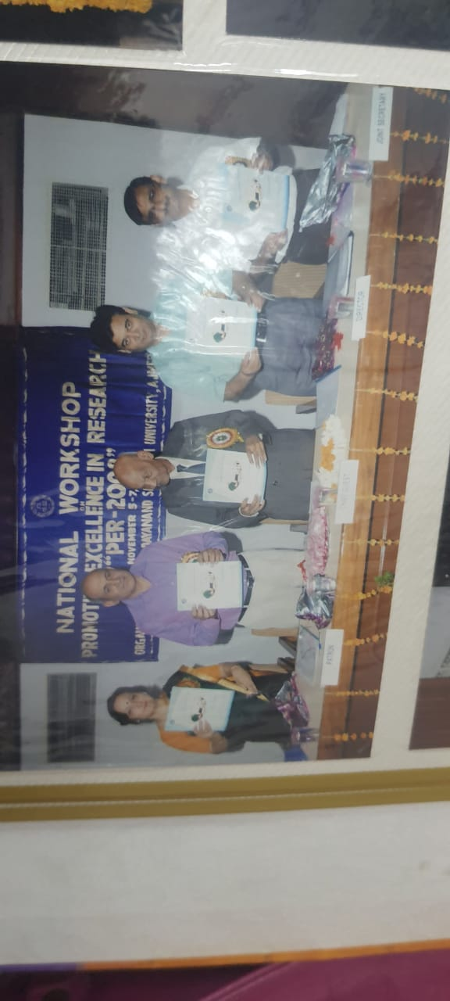

Slide 72
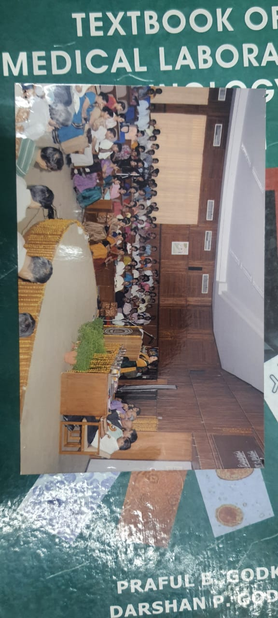

Slide 73
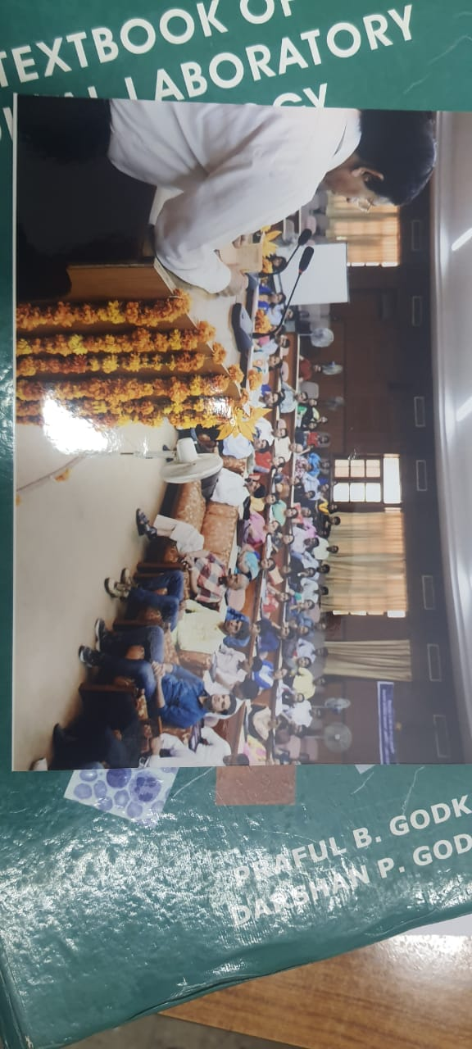

Slide 74
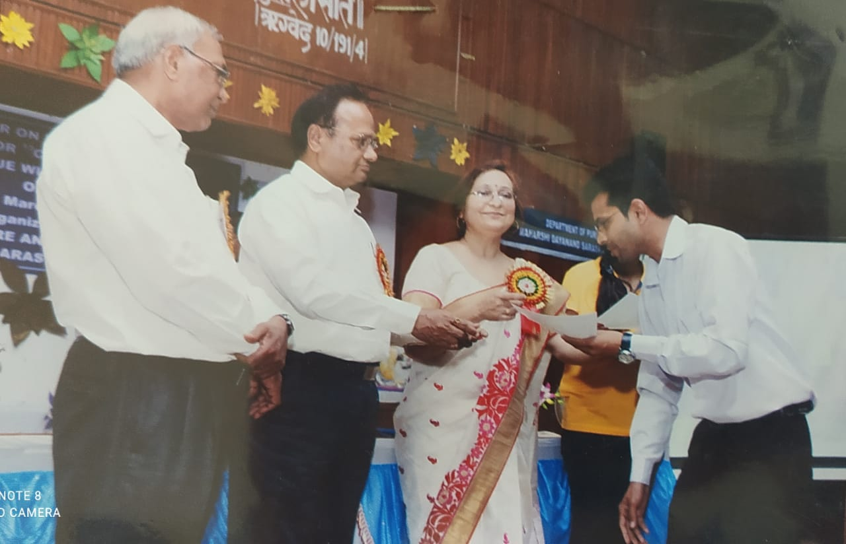

Slide 75
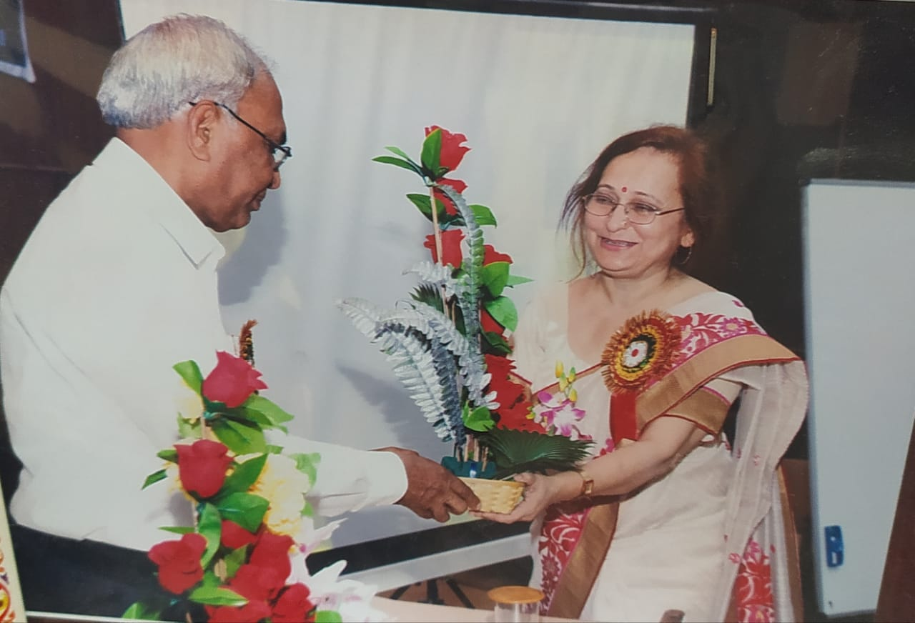

Slide 76
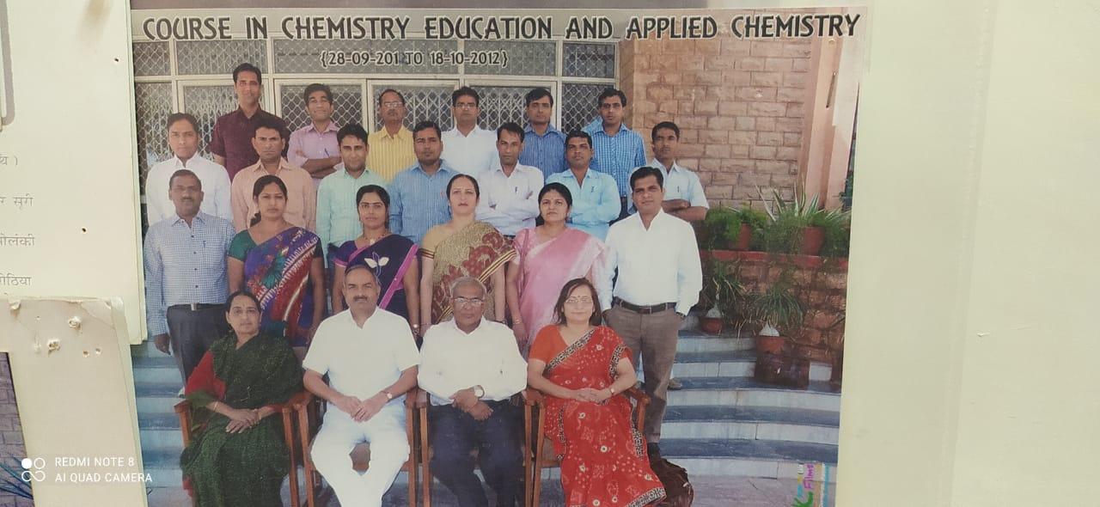

Slide 78
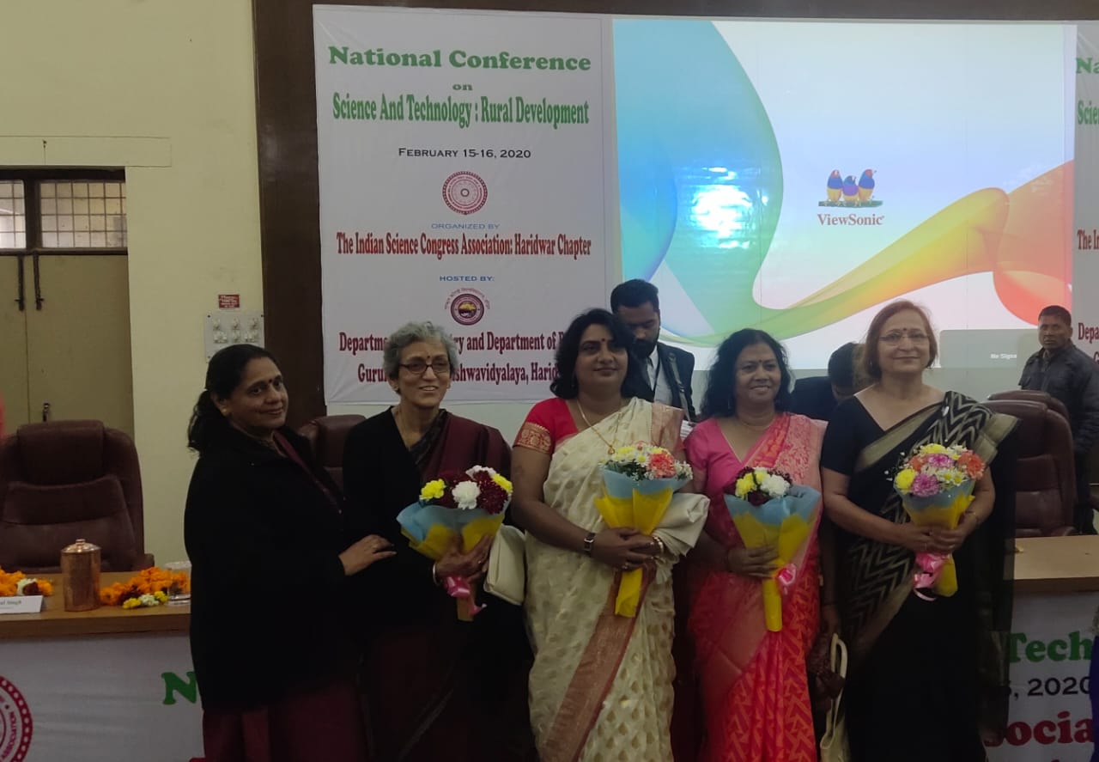
Glimpse Of Invited Lectures And
SessionS ChairED By Department
Faculty Prof R. Mehra

Slide 79
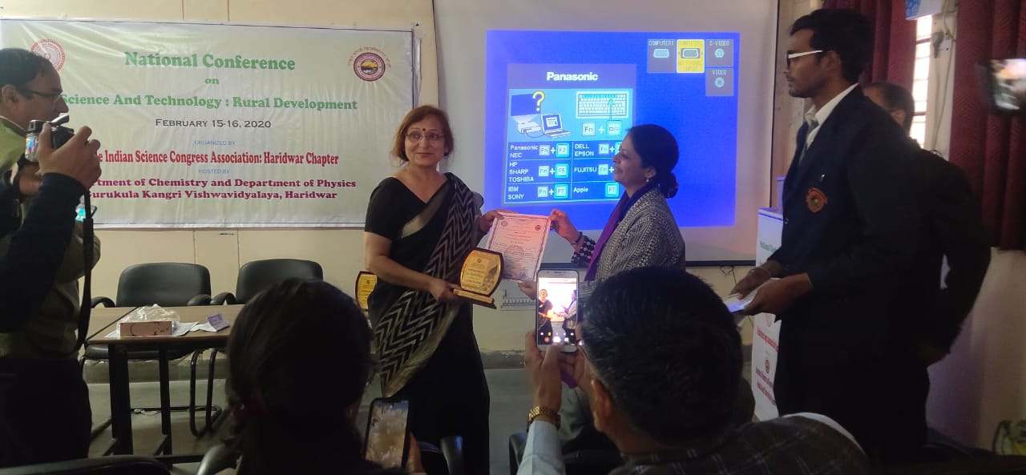

Slide 80
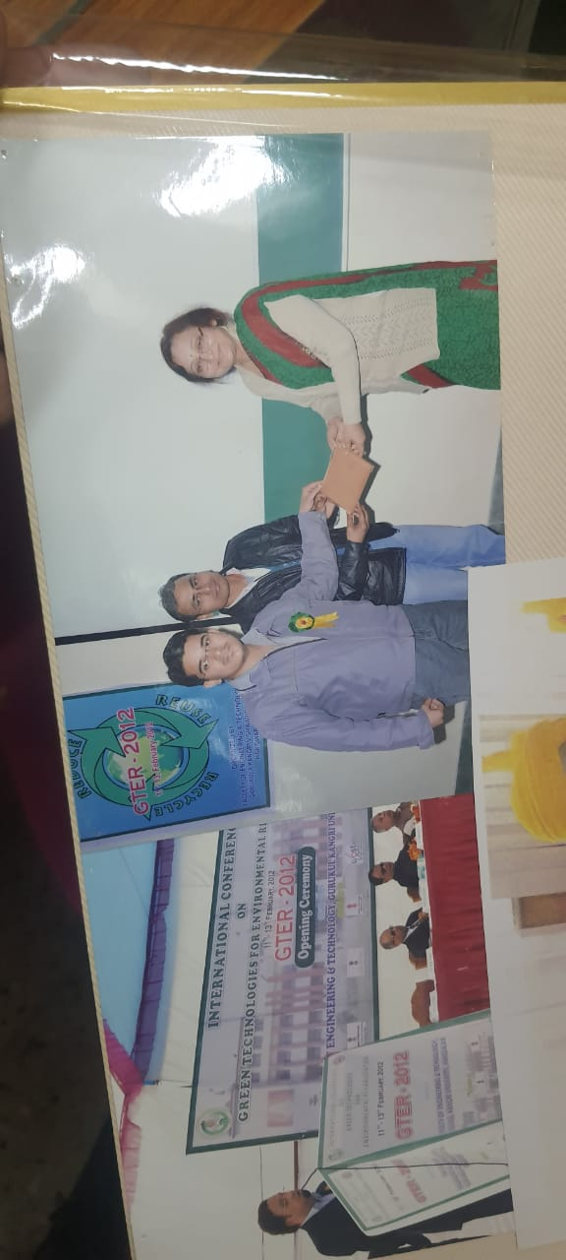

Slide 81
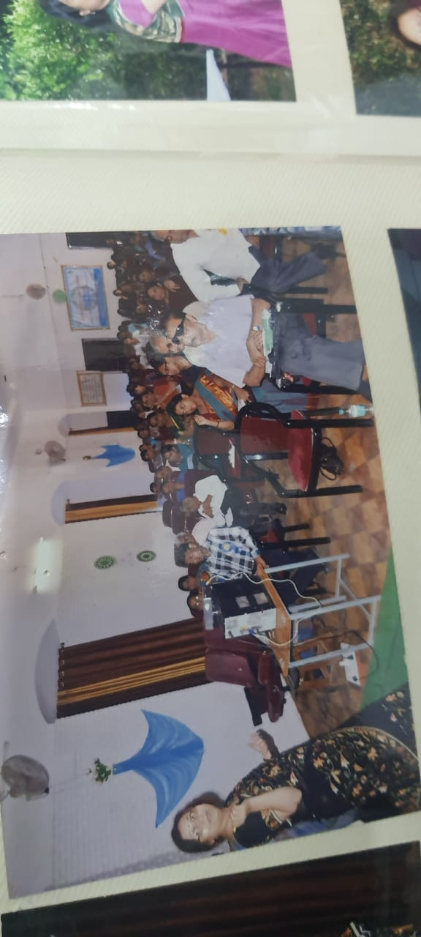

Slide 87
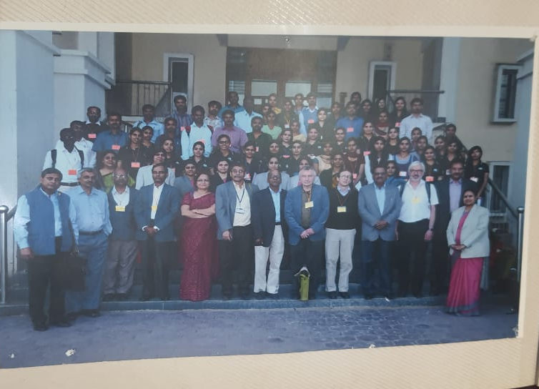

Slide 89
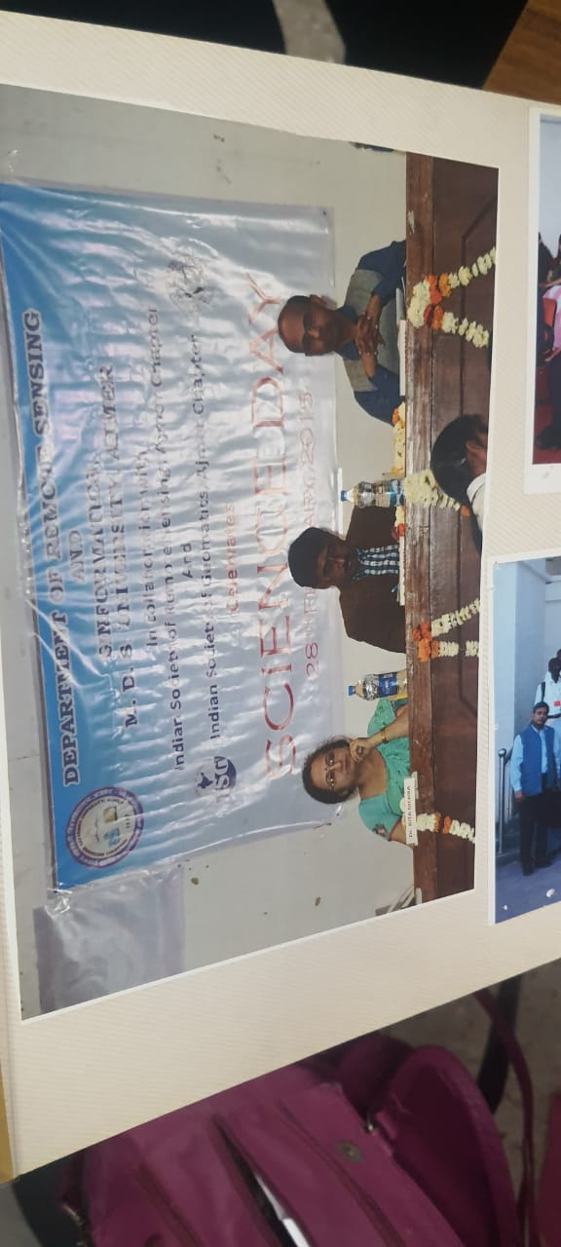

Slide 92
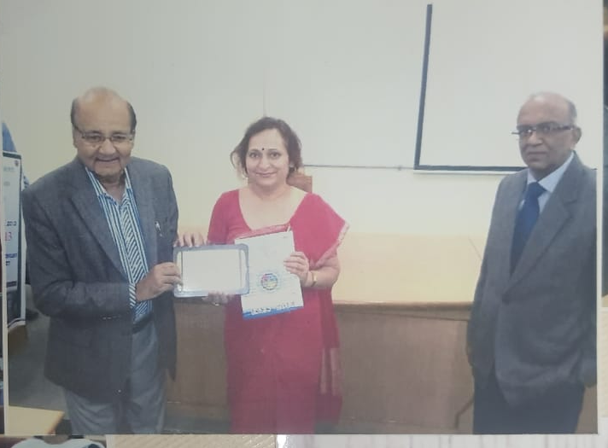

Slide 94
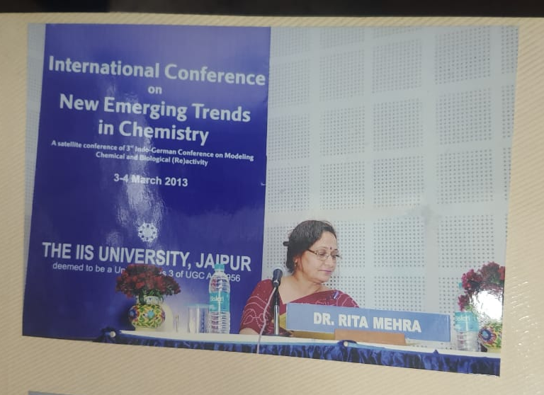

Slide 96
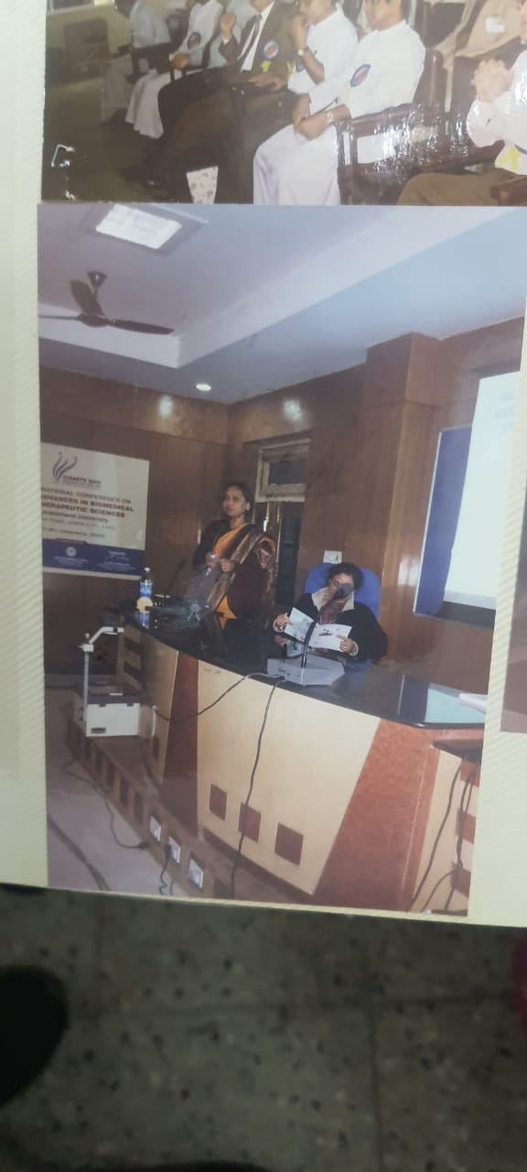

Slide 97
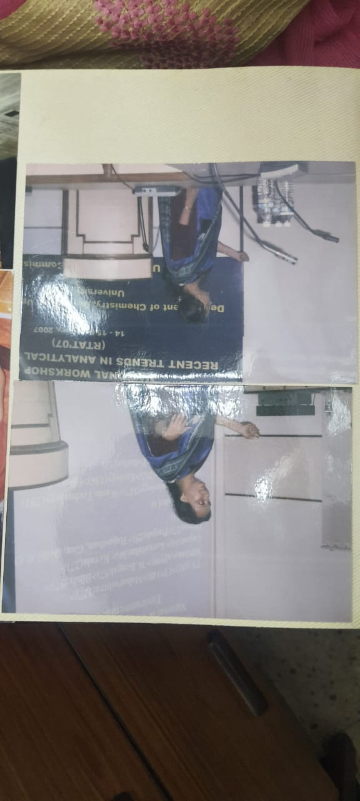

Slide 98
We are Proud of
Pooja Tomar, M.Sc. Applied Chemistry, Associate Professor, Government Engineering College, Ajmer
Ashish Gupta, M.Sc. Applied Chemistry Manager R & D/ PV, Quality Sun Pharmaceutical Industry Ltd. Gurgaon
Mithlesh Singh, M.Sc.Chemistry, Assistant Manager Lab. ,Indian Oil Corporation ,Nishatpura Bhopal
Jagdish Meena, M.Sc.Chemistry, Lecturer, Government College, Karauli
Amit Bansiwal, M.Sc. Applied Chemistry, Senior Scientist and Associate Professor, National Environment Research Institute (NEERI) Nagpur
Vinayak Sahal, M.Sc. Applied Chemistry, Assistant Superintendent Chemist, Archeological Survey of India Chandigarh
Mukesh Chand Agarwal, Research Scientist, Sophisticated and Analytical Instrument Laboratory ,Thapar R & D Technical Campus Patiala (Punjab)

Slide 99
Devesh Mahla, Indian Polish Service, Goa
Arun Jain, Chemical and Metallurgical Assistant, Indian Railways
Pawan Sharma, Chemical and Metallurgical Assistant, Indian Railways
Nirmal Choudhary, Chemical and Metallurgical Assistant, Indian Railways
Chhagan Lal, AG-III Food Corporation of India, Chandigarh
Madhu Toshniwal, M.Sc.Applied Chemistry,Assistant Professor, Government Women Engineering College Ajmer
Kamod Singh Meena, Lecturer MLV Government College, Bhilwara
Satish Kumar Goyal, Scientific Assistant BARC, Bombay
Arvind Kumar Meena, Lecturer, Government PG College, Tonk
Amit Singh Thakur, Assistant Prof. IPS Academy, Indore (M.P.)
Mukesh Sharma, M.Sc.Applied Chemistry, Ph.D, CSIR- CSMCRI, Post Doctoral Fellow, University of AVEIRO Portugal
Shivpal Singh, Chemist (Quality Control) at Acme Generics LTD Baddi, Himachal Pradesh

Slide 100
Bhagywati Varma, Junior Chemist, Regional Agmark Laboratory, Mumbai
Bharat Kumar Purushwani, Senior Research Associate R & D Department SRF Ltd. Bhiwadi, Rajasthan
Mahendra Kumar Saini, Analyst Training State Central Public Help Laboratories, Rajasthan
Rekha Israni, M.Sc.Applied Chemistry,HOD, Department of Applied Sciences, Bhagwant University, Ajmer
Amit Mundra, M.Sc. Applied Chemistry, Senior Chemist, Chambal Fertilizers and Chemicals Limited Kota
Mewa Ram Chaudhary, M.Sc.Applied Chemistry, ,Shree Cement Ltd. Beawar
Neha Nagar, M.Sc. App. Chem.Senior Executive, Flareum Technology, Valsad, Gujarat
Ram Prashad Dhakar, M.Sc.Applied Chemistry,, Udaipur Mineral Syndicate Private Ltd. Golcha Group, Jaipur
Mahavir Prasad Awwal , Sr. Officer, Shree Cement Ltd.Beawar
Surya Komal Ajmera, Officer, Shree Cement Ltd. Beawar

Slide 101
Rajesh Kumar Mehra, Junior Lab. Assistant, Central Drug Laboratory, Kolkatta
Arvind Sehra, M.Sc.Chemistry ,Officer Bank Of Baroda, Jaipur
Manish Upadhyay, Major,16Raj.Rif,C/O 99APO, Army Services
Sonal Meghani ,M.Sc. Applied Chemistry, ,Officer (QC) ,Sun Pharmaceutical Industries Ltd., Halol,Gujarat
Shashikant Meena, Senior Research Asstt, Central Water Commission, Agra
Deepak Khushwaha, HOD, Shree Cement Ltd. Khushkhera Unit, Alwar
Ranveer Singh, Senior Auditor, at O/O Principal Director Audit,Jaipur
Mukesh Bagoriya, Analyst (Lab) Ambuja Cement ,Rabriyawaas
Harish Kumar Udeniya , Chemist, Rajasthan Rajya Vidyut Udpadan Nigam
Devendra Kumar, Process Associate, Hindustan Zinc Ltd. Chittorgarh
Poonam Kumari, Junior Scientific Officer, Regional Office Rajasthan Pollution Control Board
Shankar Sharma, Officer, Shree Cement Ltd.Beawar

Slide 102
Jitendra Singh Shekhawat,M.Sc.Applied Chemistry , JK Lakshmi Cement, Sirohi
Mukesh Bagoriya, Ambuja Cement Ltd.
Paramjeet Singh, Assistant Director, Forensic Science Laboratory, Jaipur
Virendra Singh Chandawat, M.Sc.Chemistry, JK White Cement , Gottan
Gaurav Sharma, M.Sc.Applied Chemistry, Sr. Officer, Shree Cement Ltd. ,Beawar
Deepak Sankhla, M.Sc.Applied Chemistry,, Officer, Shree Cement Ltd. RAS (Pali)
Hemant Kumar Sunaiya, Officer,Shree Cement Ltd. Beawar
Ram Kishore, M.Sc.Chemistry,Shree Cement Ltd. Beawar
Gajraj Singh, Officer, Shree Cement Ltd. Beawar

Slide 103
Virendra Singh Chandawat, M.Sc. Chemistry , Shree Cement Pvt. Ltd. Suratgarh Shriganganar
Devendra Singh Rathore, M.Sc. Applied Chemistry , J.K. WHITE Cement GOTAN
Naresh Singh, Officer, Shree Cement Ltd. Beawar
Ravi Shankar Joshi , Ultra Tech Cement Ltd., Chittorgarh
Jitendra Singh Shekhawat, M.Sc. Applied Chemistry , JK Cement, Banas (Sirohi)
Aashish Sharma , M.Sc. Applied Chemistry, , Assistant Officer (Quality Control),Shree Cement Ltd. RAS (Pali)
Ram Prasad Dhakar, M.Sc. Applied Chemistry, , Udaipur Mineral Development Syndicate Pvt. Ltd. , Golcha Group, Jaipur
Sandeep Kumar Gaur, M.Sc. Applied Chemistry , IPQC Chemist, Maneesh Pharmaceuticals Ltd., Baddi (H.P.)
Rahul Raghav, M.Sc. Applied Chemistry , Trainee (Quality Control) at Shree Cement Ltd. RAS (Pali)
Purnima Malviya ,M.Sc. Applied Chemistry, NION Parkarizing Pvt.Ltd., Neemrana, Alwar

Slide 104
63. Purnima Malviya ,M.Sc. Applied Chemistry, NION Parkarizing Pvt.Ltd., Neemrana, Alwar
Sunita Dewna, M.Sc.Applied Chemistry , Nion Parkarizing, India Pvt. Ltd., Neemrana, Alwar
OM Prakash Goutam, M.Sc.Applied Chemistry ,Shree Cement Ltd.,RAS (Pali)
Mewa Ram Chaudhary, M.Sc.Applied Chemistry, Shree Cement Ltd. Beawar

Slide 105
Course Coordinator , Refresher Course in Human Rights and Women Empowerment , UGC-HRDC, MDS University Ajmer, 2018-19
Coordinator, Orientation Programme (2nd to 29th January), UGC-HRDC, MDS University Ajmer, 2018-19
Course Coordinator, Short Term Course in Guiding Research: Present Scenario, UGC-HRDC, MDS University Ajmer, 2018-19
Course Coordinator, Refresher Course in Chemical and Physical Sciences, UGC-HRDC, MDS University Ajmer, 2018-19
Course Coordinator, Refresher Course in Research Methodology and Ethics , UGC-HRDC, MDS University Ajmer, 2018-19
Coordinator, Orientation Programe(7th Feb to 6th March), UGC-HRDC, MDS University Ajmer ,2018-19
GLIMPSE OF Additional contribution oF H.O.D , Prof. R. Mehra as director academic staff college

Slide 106
Course Coordinator, Refresher Course in Library Science , UGC-HRDC, MDS University Ajmer 2017-18
Course Coordinator , Refresher Course in Computer Applications, UGC-HRDC, MDS University Ajmer ,2017-18
Course Coordinator, Refresher Course in Globalization and Emerging Economic Trends, UGC-HRDC, MDS University Ajmer 2017-18
Coordinator , Principals‟ Meet, UGC-HRDC, MDS University Ajmer,2017-18
Coordinator , Orientation Programme (5th Feb to 4th March), UGC-HRDC, MDS University Ajmer,2017-18
Coordinator, Orientation Programme (12th Feb to 11th March), UGC-HRDC, MDS University Ajmer,2017-18
Coordinator , Research Scholars Workshop on Information Technology and Research Ethics, UGC-HRDC, MDS University Ajmer,2017-18

Slide 107
Course Coordinator, Refresher Course in Chemistry, UGC-ASC, MDS University Ajmer, 2007-08
Course Coordinator, Refresher Course in Educational Management, UGC-ASC, MDS University Ajmer, 2007-08
Coordinator, Special Summer School-2008, UGC-ASC, MDS University Ajmer, 2008-09
Coordinator, Refresher Course in Political Science 2011 UGC-ASC MDS University Ajmer as Director ASC.
Course Coordinator, Refresher Course in Renewable Energy Studies,UGC-HRDC , MDS University Ajmer, 2017-18
Course Coordinator, Refresher Course in Chemistry Education and Applied Chemistry, UGC-ASC, MDS University Ajmer, 2012-13
Coordinator, Special Winter School 2008-09, UGC-ASC, MDS University Ajmer

Slide 108
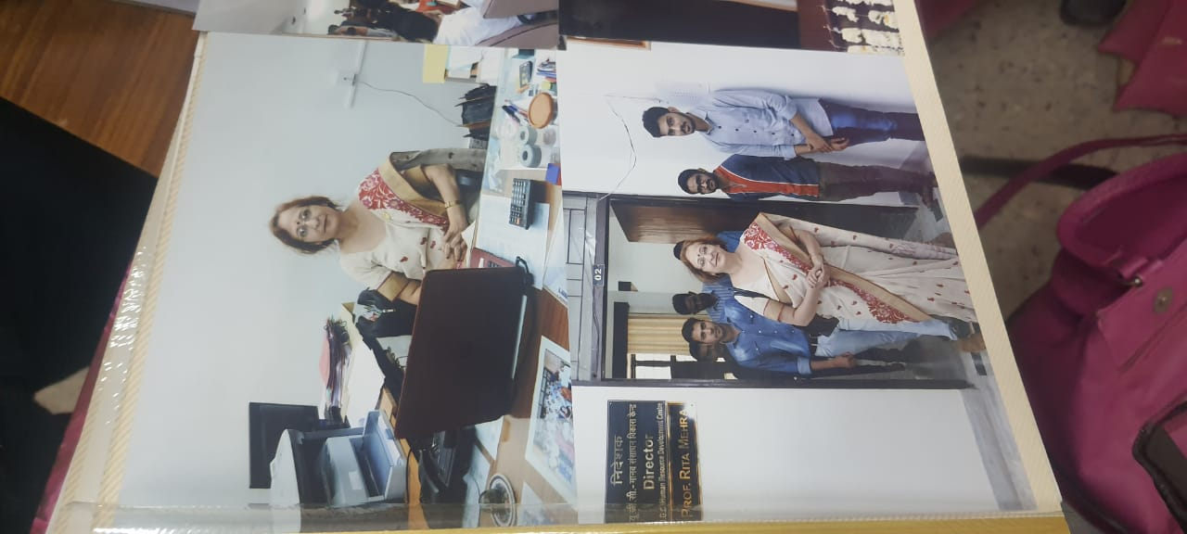

Slide 109
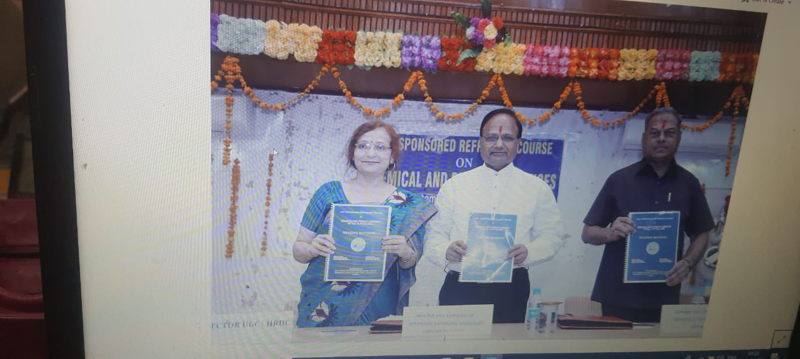

Slide 110
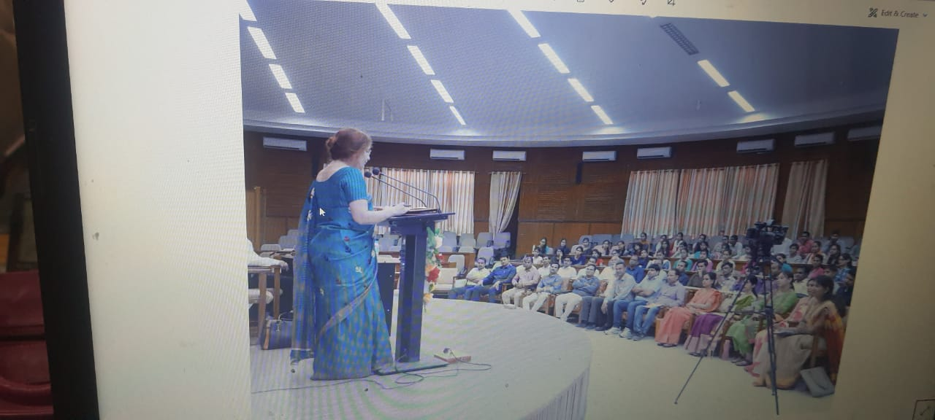

Slide 112
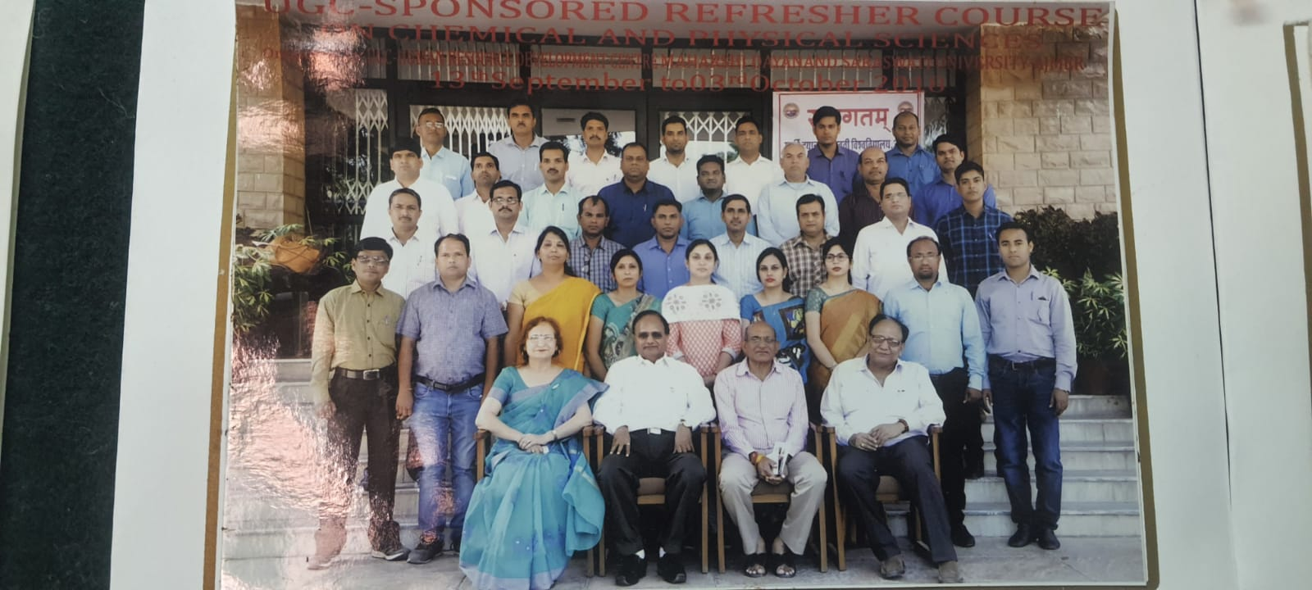

Slide 113
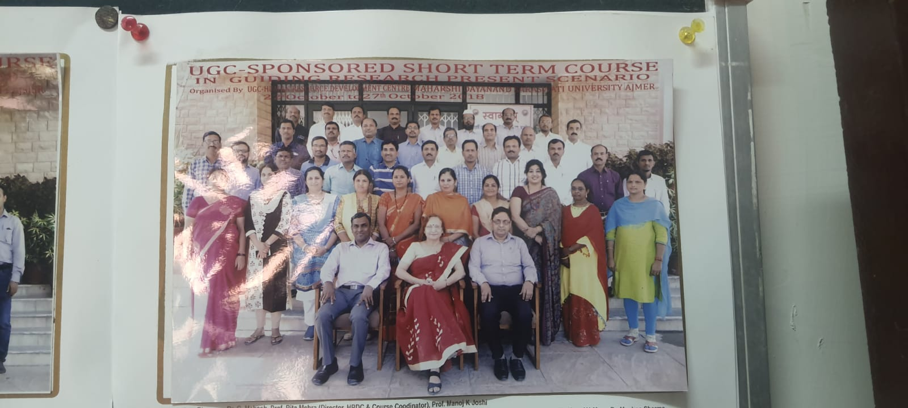

Slide 116
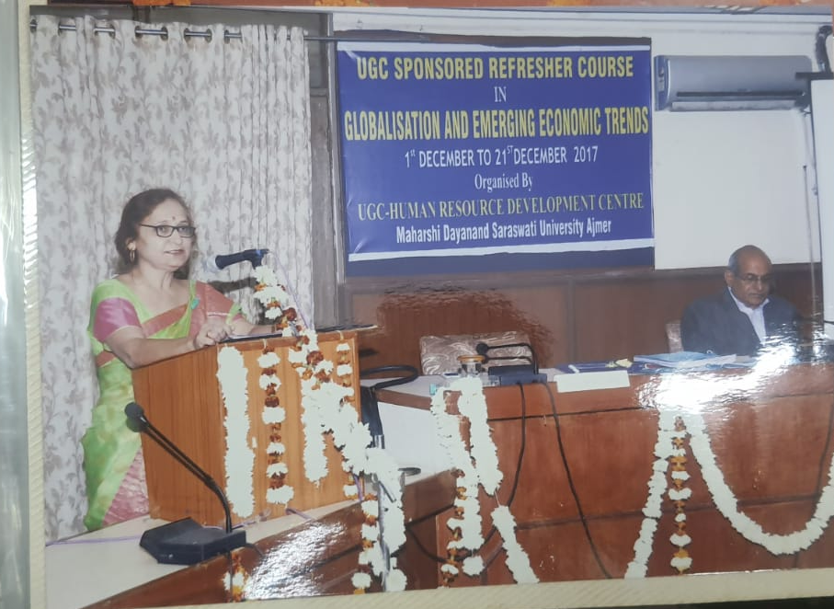

Slide 117
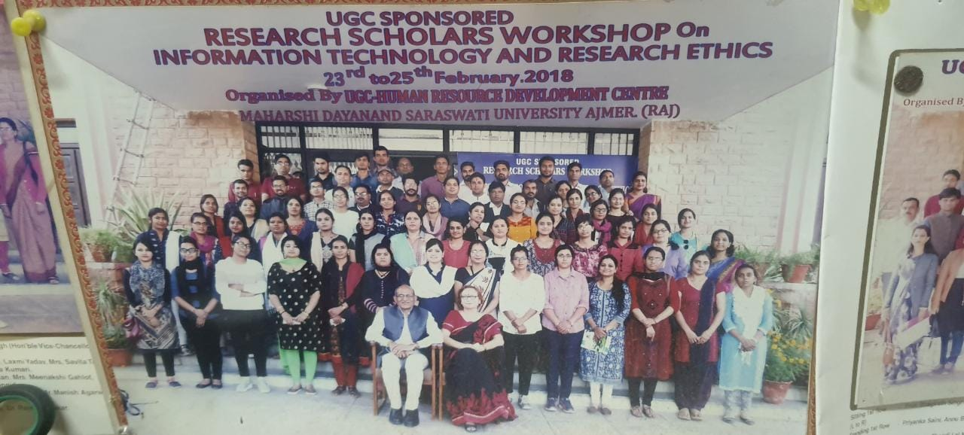

Slide 118
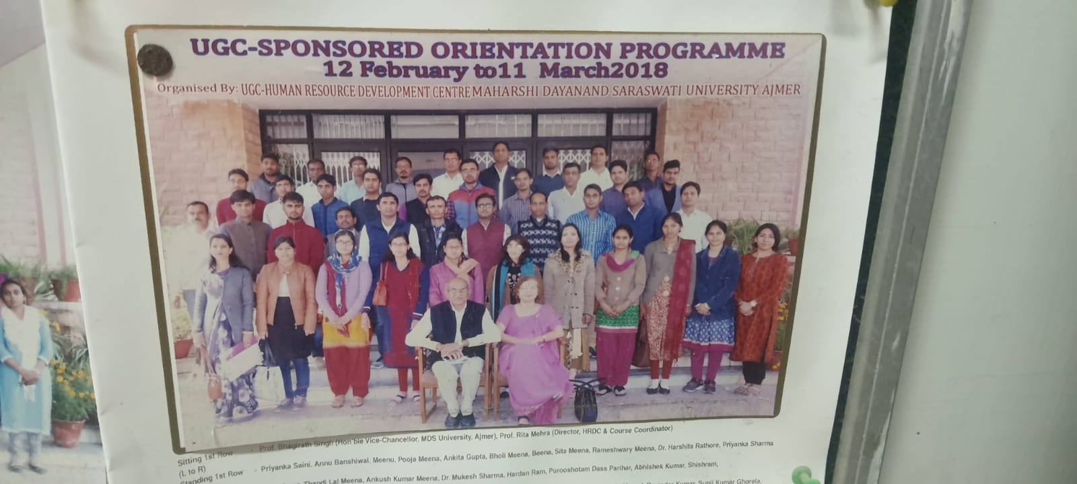

Slide 119
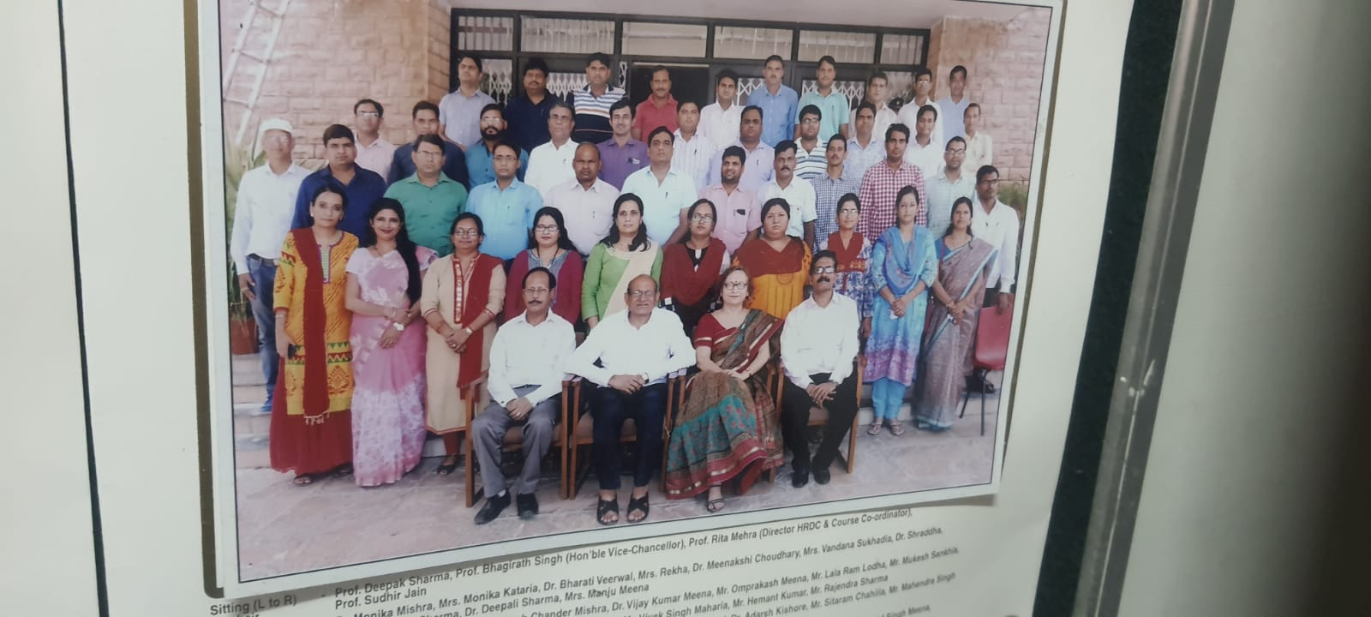

Slide 120
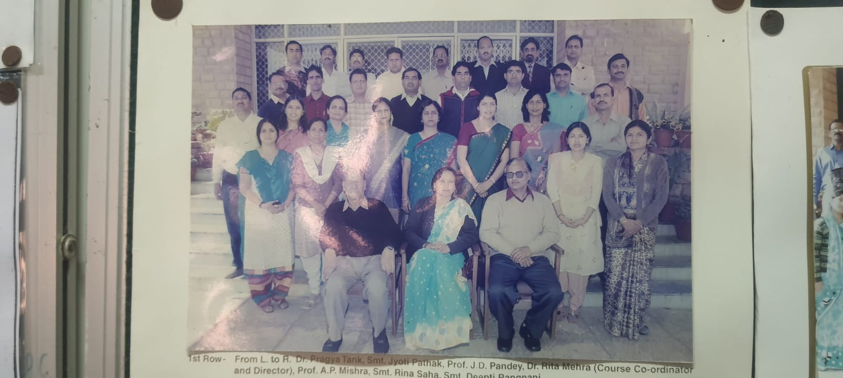

Slide 121
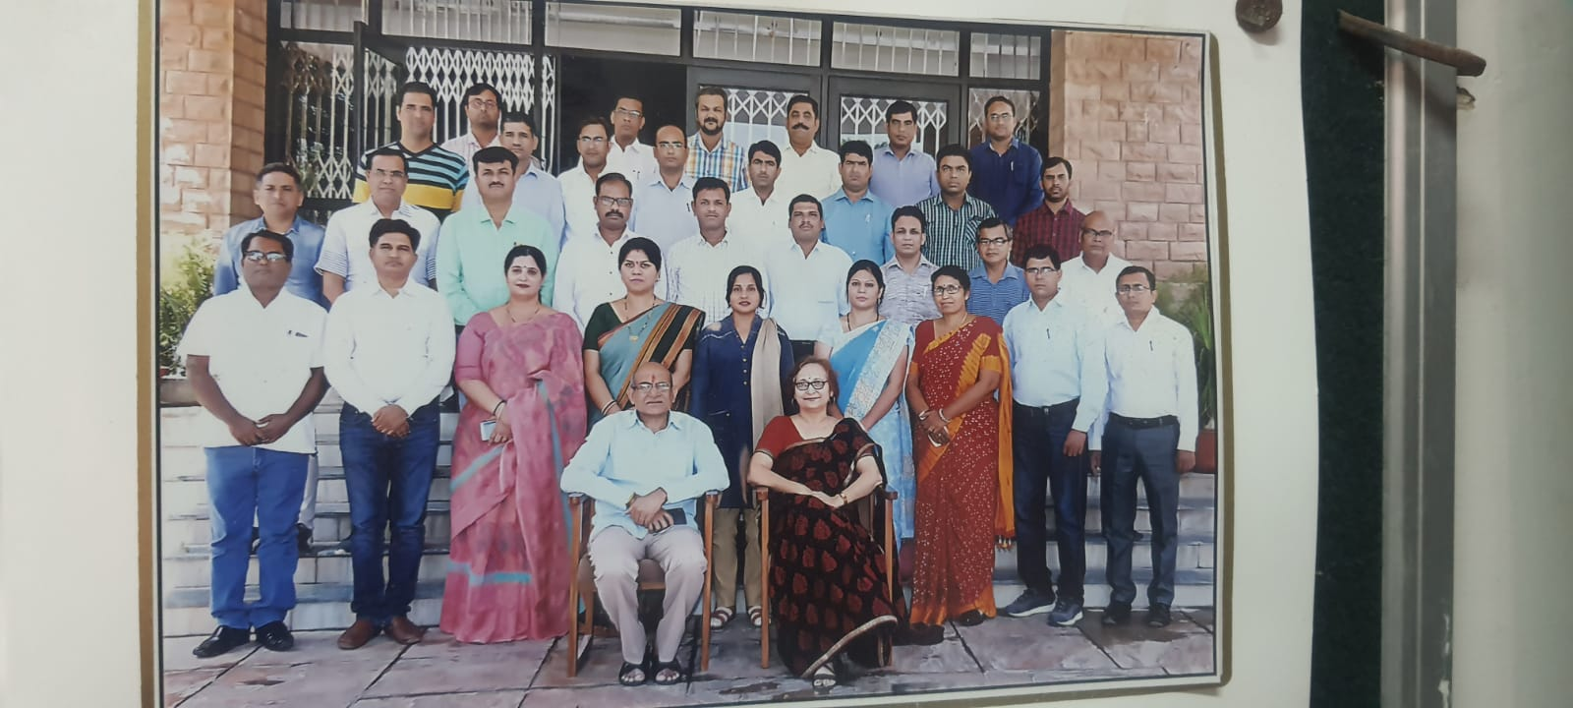

Slide 122
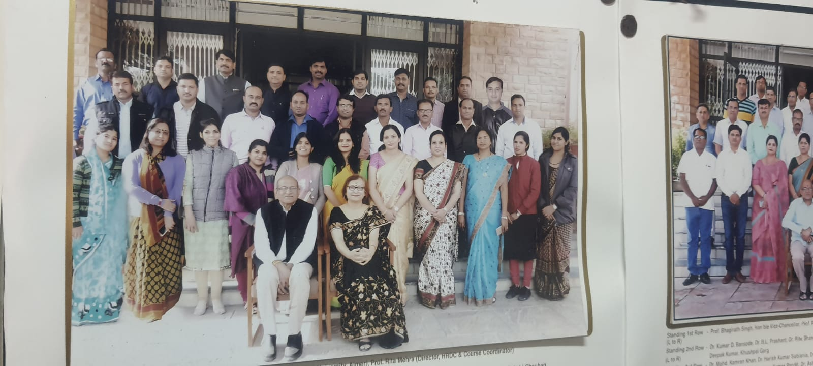

Slide 123
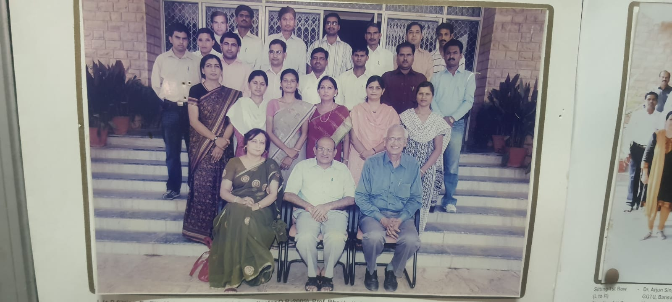

Slide 142
Student participation in Co-curricular and CULTURAL activities Organized by The Department–
The students of the Department are allowed to participate in all the Seminars and Co-curricular Activities organized by the Department for their academic enhancement and personality development.
1 UGC Sponsored National Seminar on Innovative Teaching Methodology for 2D NMR Spectroscopy – A Technique with Difference on 21st March 2013 as Convener
2. National Seminar on Innovative Teaching Methodology for ¹³C NMR Spectroscopy – A Technique with Difference on 25st March 2015 as Convener
3. UGC sponsored National Seminar on Mass Spectroscopy on 17th October 2015 as Convener
4.Co-curricular Activity - Department organized co-curricular activities for all round development of students viz.
5. Chemism – Exhibition on Working Chemistry Models-An exhibition was put up to show the applications of Chemistry and Applied Chemistry on 30.9.2014
6. Chemistry of Divinity – Concepts of Chemistry in Ancient Vedic Literature and Divine number 108 cum Cultural Programme on 13.10.14
7. Cultural Activity “Chemic” on 1.5.2015

Slide 143
‘
Chemism
An exhibition
on
working models
AND
POSTERS

Slide 146
NATIONAL SCIENCE
DAY
28 FEB. 2021
SPEECH
COMPETITION

Slide 147
CO-CURRICULAR
ACTIVITIES
WHAT IS
WHAT?

Slide 154
PROF. MRS. KRISHNA MISHRA , UNIVERSITY OF ALLAHABAD BEING WELCOMED BY THE STUDENTS

Slide 157
Prof. Anwar Ali, Jamia Milia Islamia Central University, being
felicitated by HOD, Dr.Rita Mehra

Slide 175
Student Participation in Community and Extension services
1. Students participated in Swachch Bharat Abhiyaan by way of drawing charts and displaying them in the Department, Essay Writing on the matter, debate competition, spreading awareness about hygiene and cleanliness by Nukkad Nataks etc in nearby areas particularly rural areas.
2. Students popularize the digital mode of payment in compliance of orders of Hon’ble Chancellor in nearby areas by acquainting the common man with different modes of cashless payments, thereby contributing to the national stride of cashless economy.

Slide 185
Strength
Dedicated and knowledgeable one permanent faculty, dedicated guest faculty on lecture basis, obedient , disciplined , regular and punctual students, good instrumental facilities, inquisitive and law abiding students.
Good Number of research publications in reputed National and International Journals.
Recognition of research work of the Department at National and International Level.
Students are easily absorbed in industries .
Alumini encourage and help the present batch of M.Sc. Students to prepare them for competitive examination.
To minimize the risk of accidents in the laboratories , a drive for lab safety is organised at the beginning of the session and first aid is also available in lab.

Slide 186
Opportunities
Students can get employment in Government organizations in teaching field and as Chemists/ Analysts etc. in industries and laboratories including forensic laboratories.
Students after qualifying NET /SET can pursue career in College and University teaching.

Slide 187
Challenges
Improving the quality of teaching by strengthening the faculty of the Department and with the support of alumini.
To create the state of the art analytical laboratories to gear up to the increasing demands in Analytical Chemistry.

Slide 188
Future Plans
Subject to infrastructure availability and academic and technical staff it is planned to start a Post-GraduateProgramme on Mineralogy and Material Sciences.

